Slide 1
Radix Sort

Slide 2
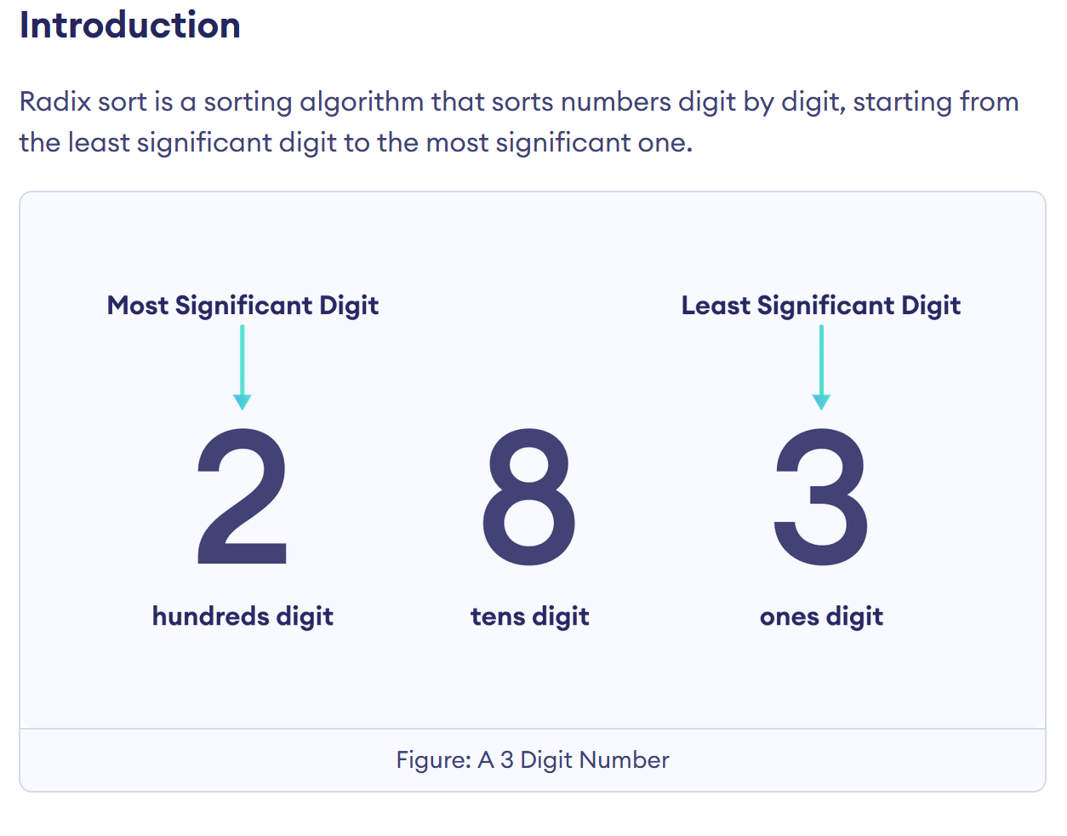

Slide 3
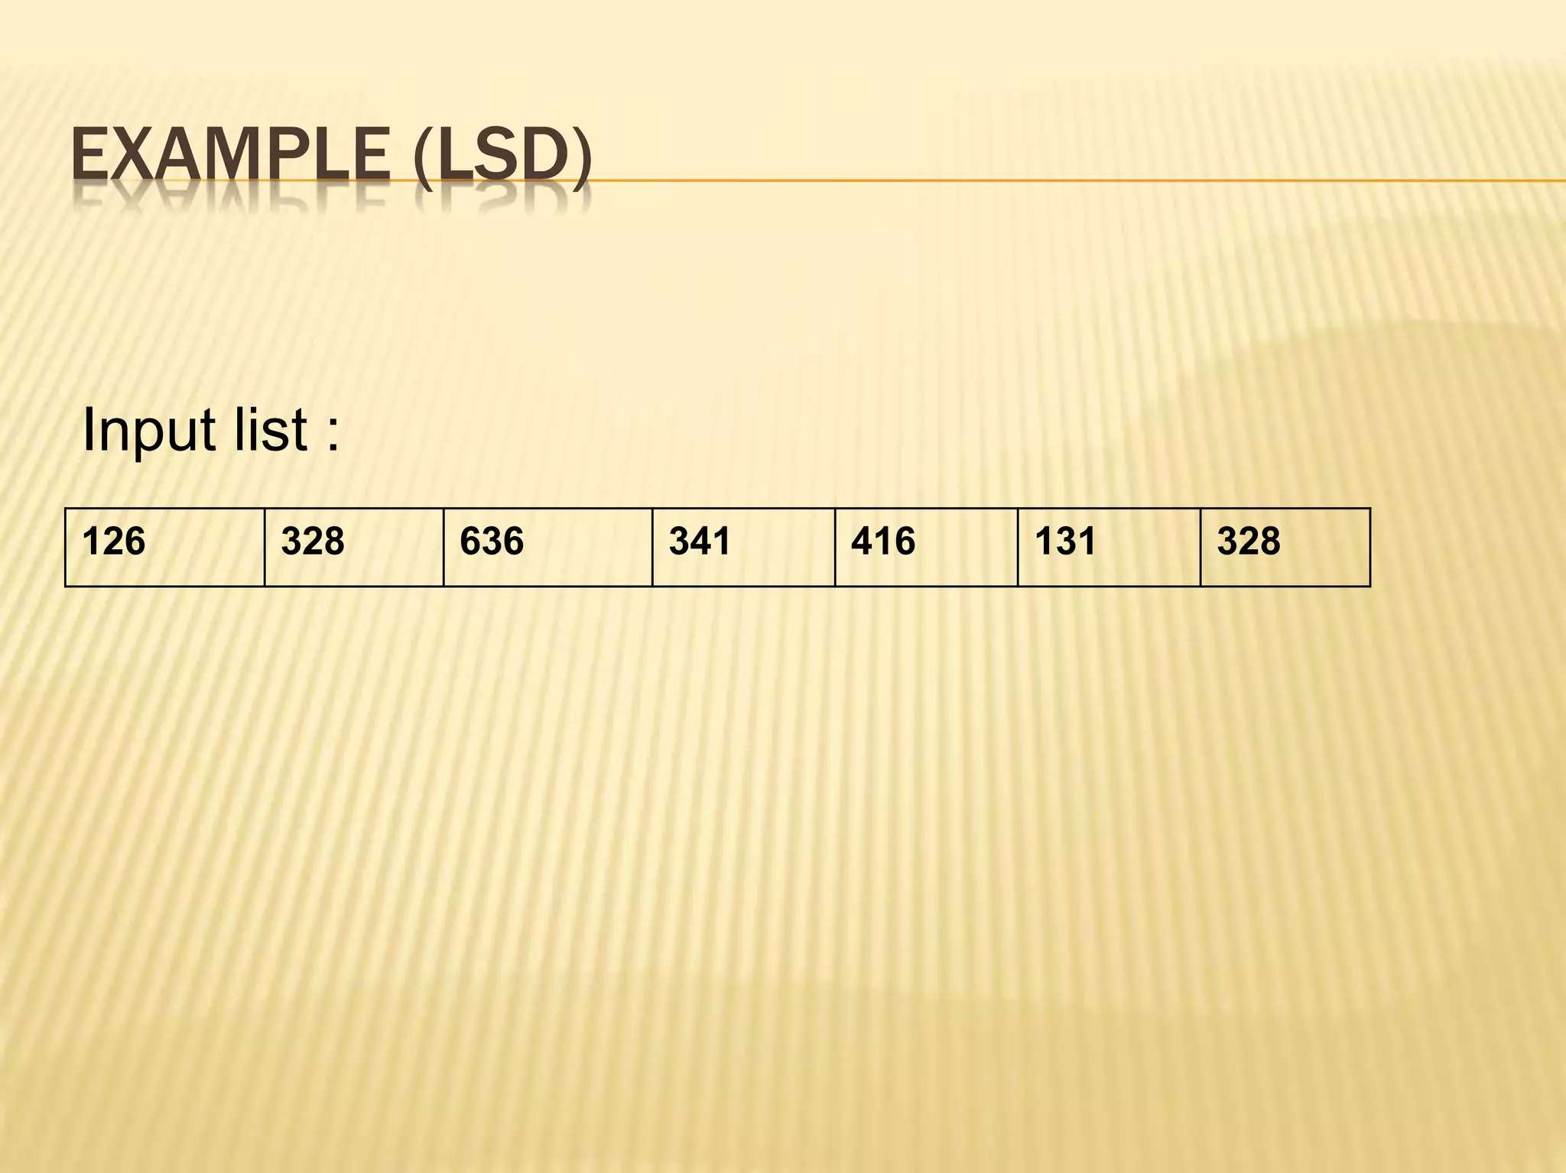

Slide 4
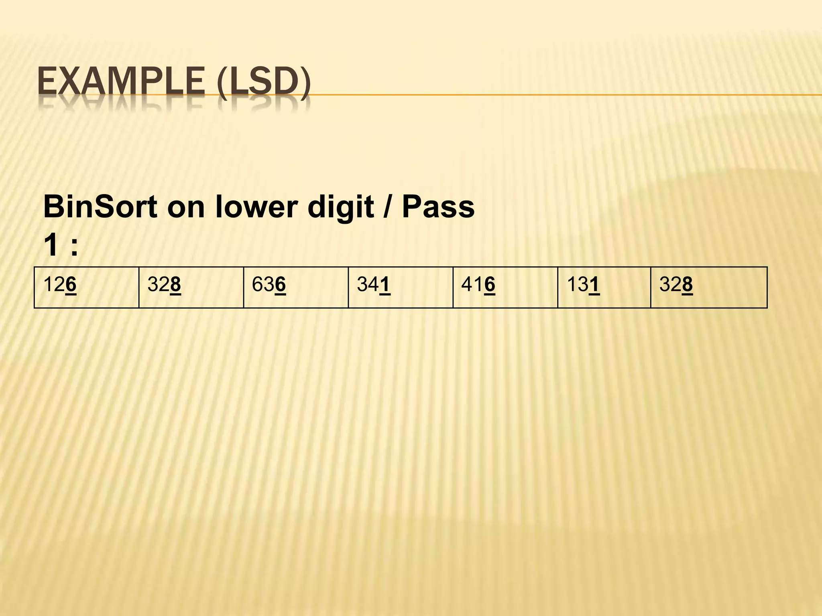
PASS 1:

Slide 5
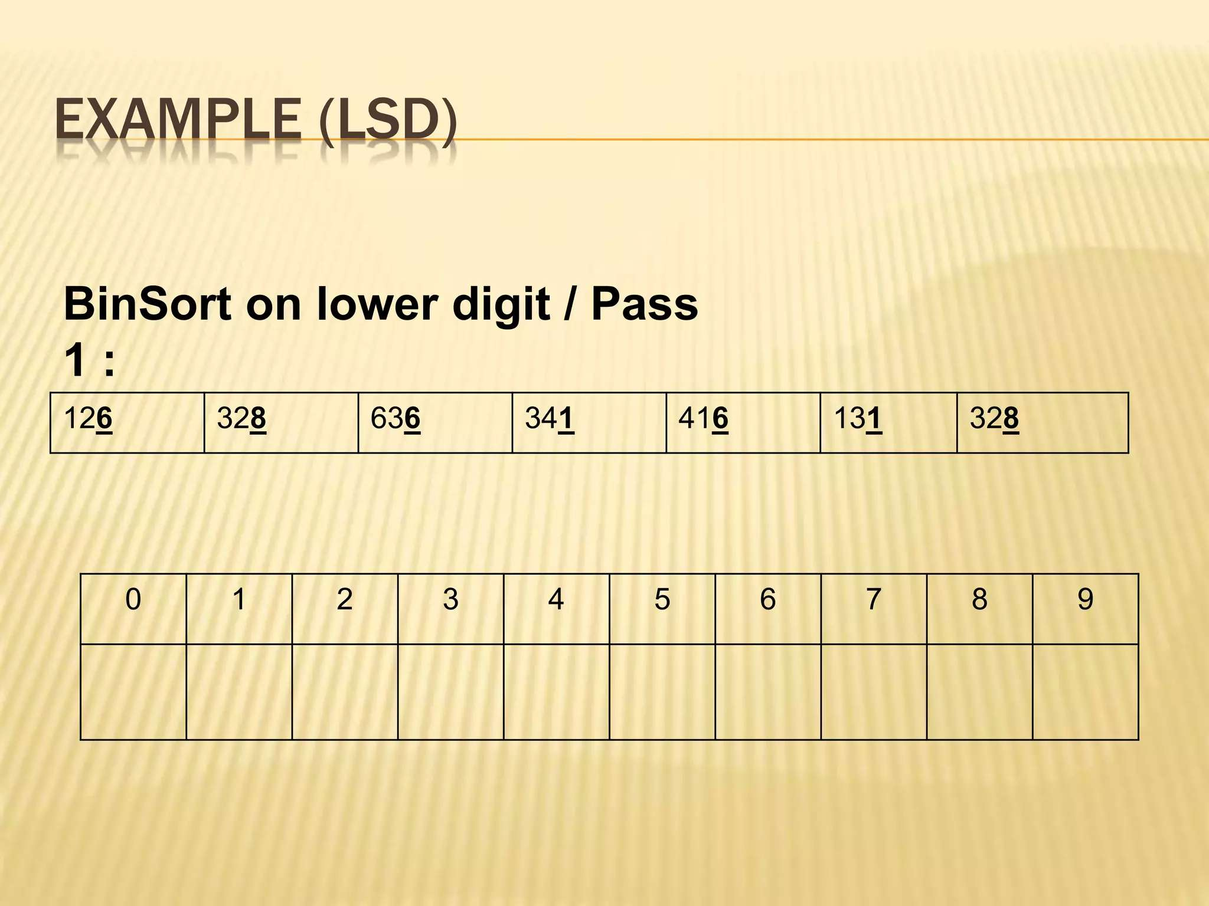
PASS 1:

Slide 6
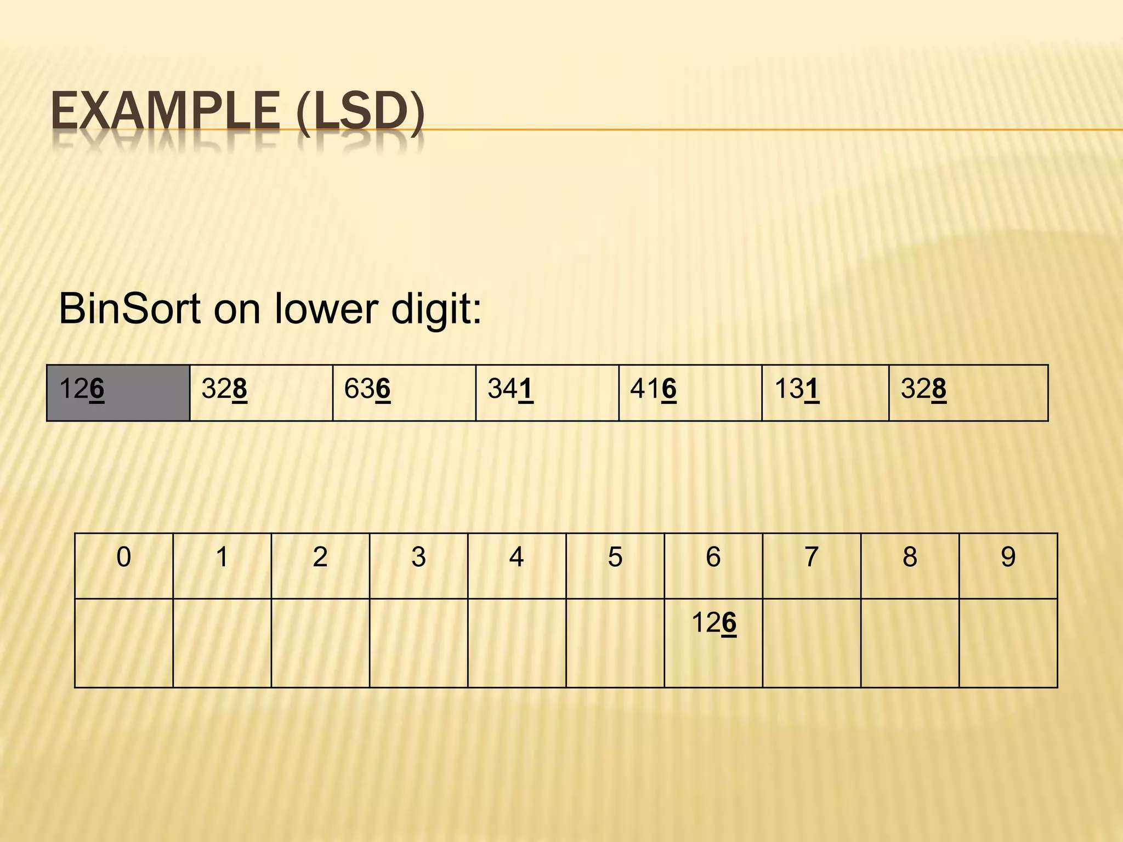
PASS 1:

Slide 7
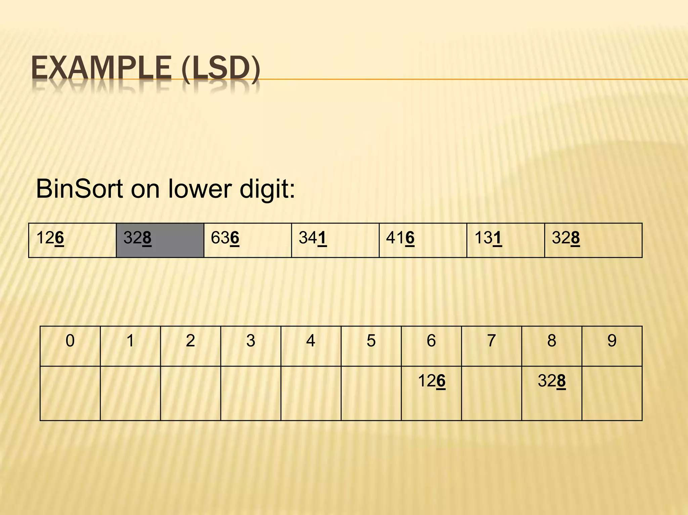
PASS 1:

Slide 8
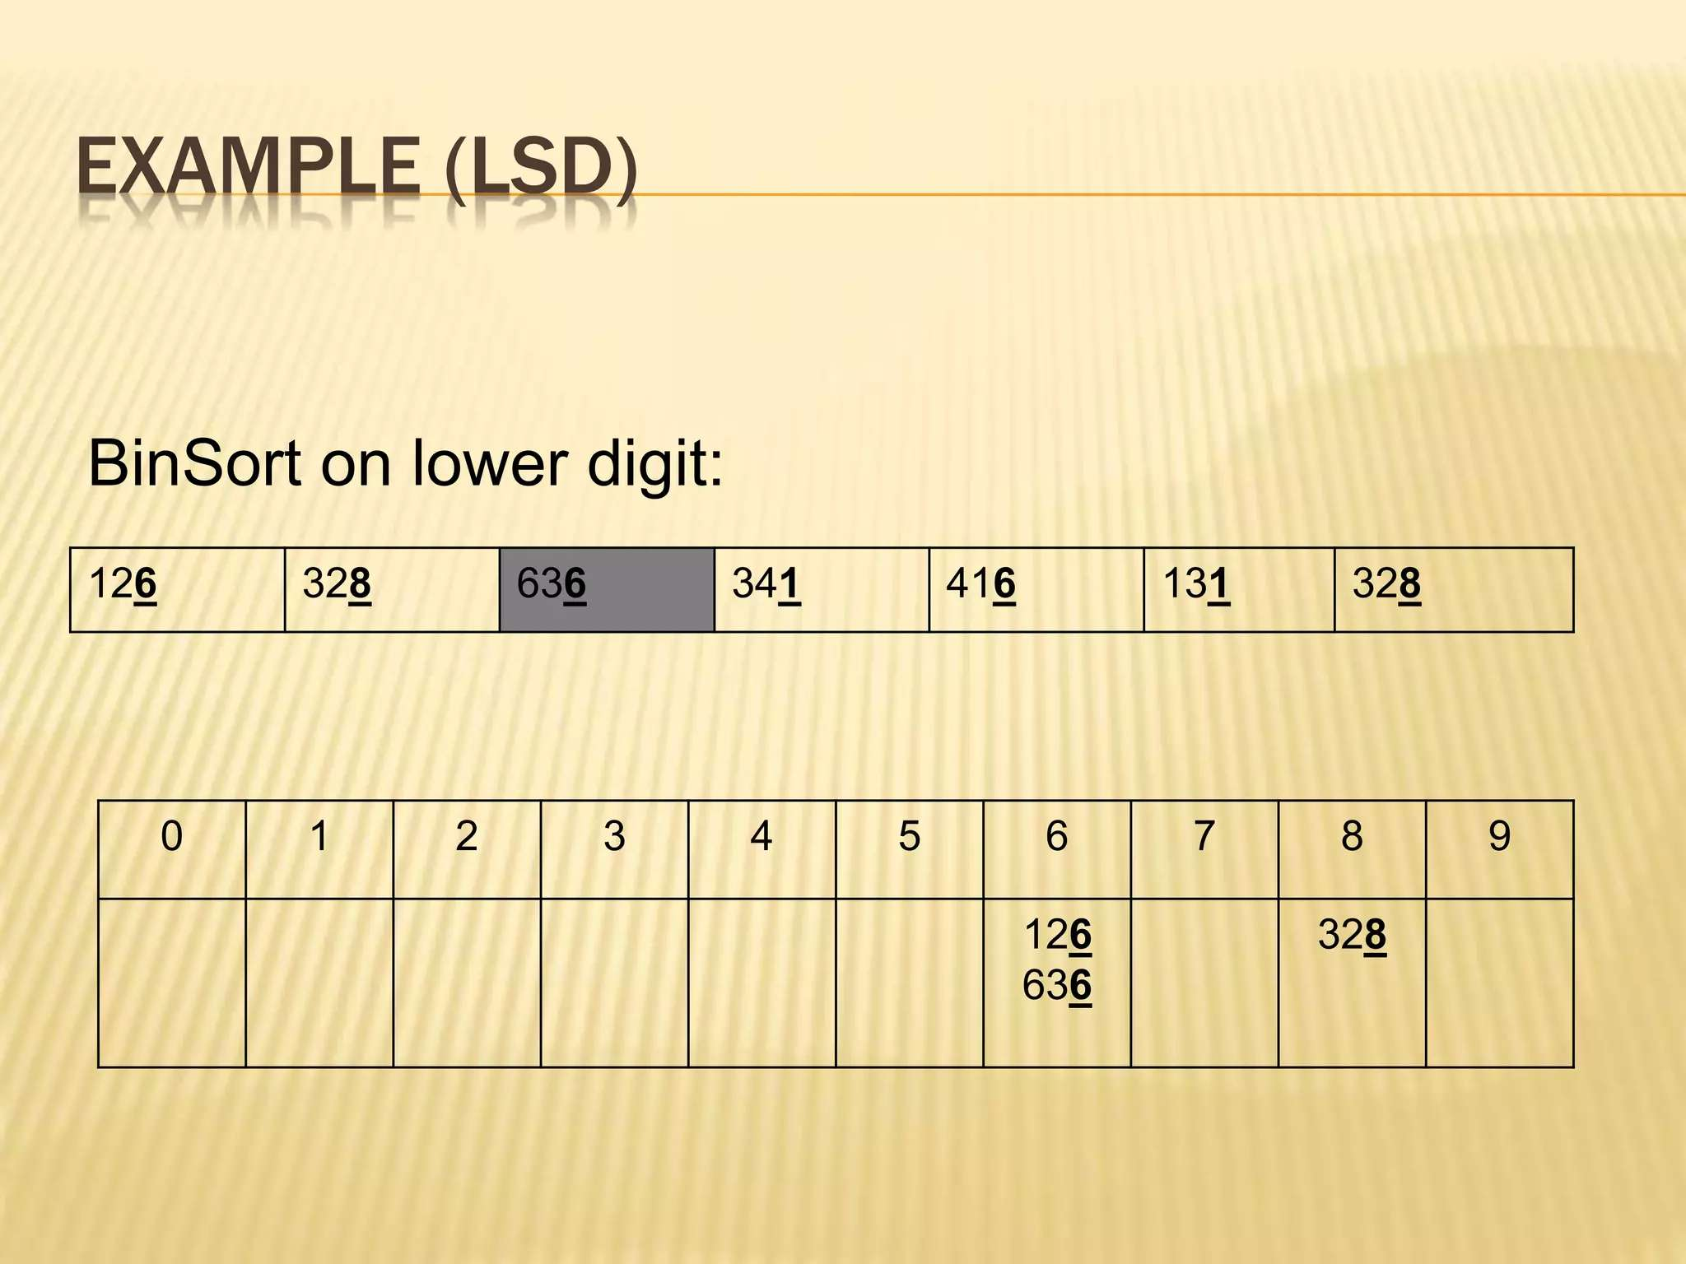
PASS 1:

Slide 9
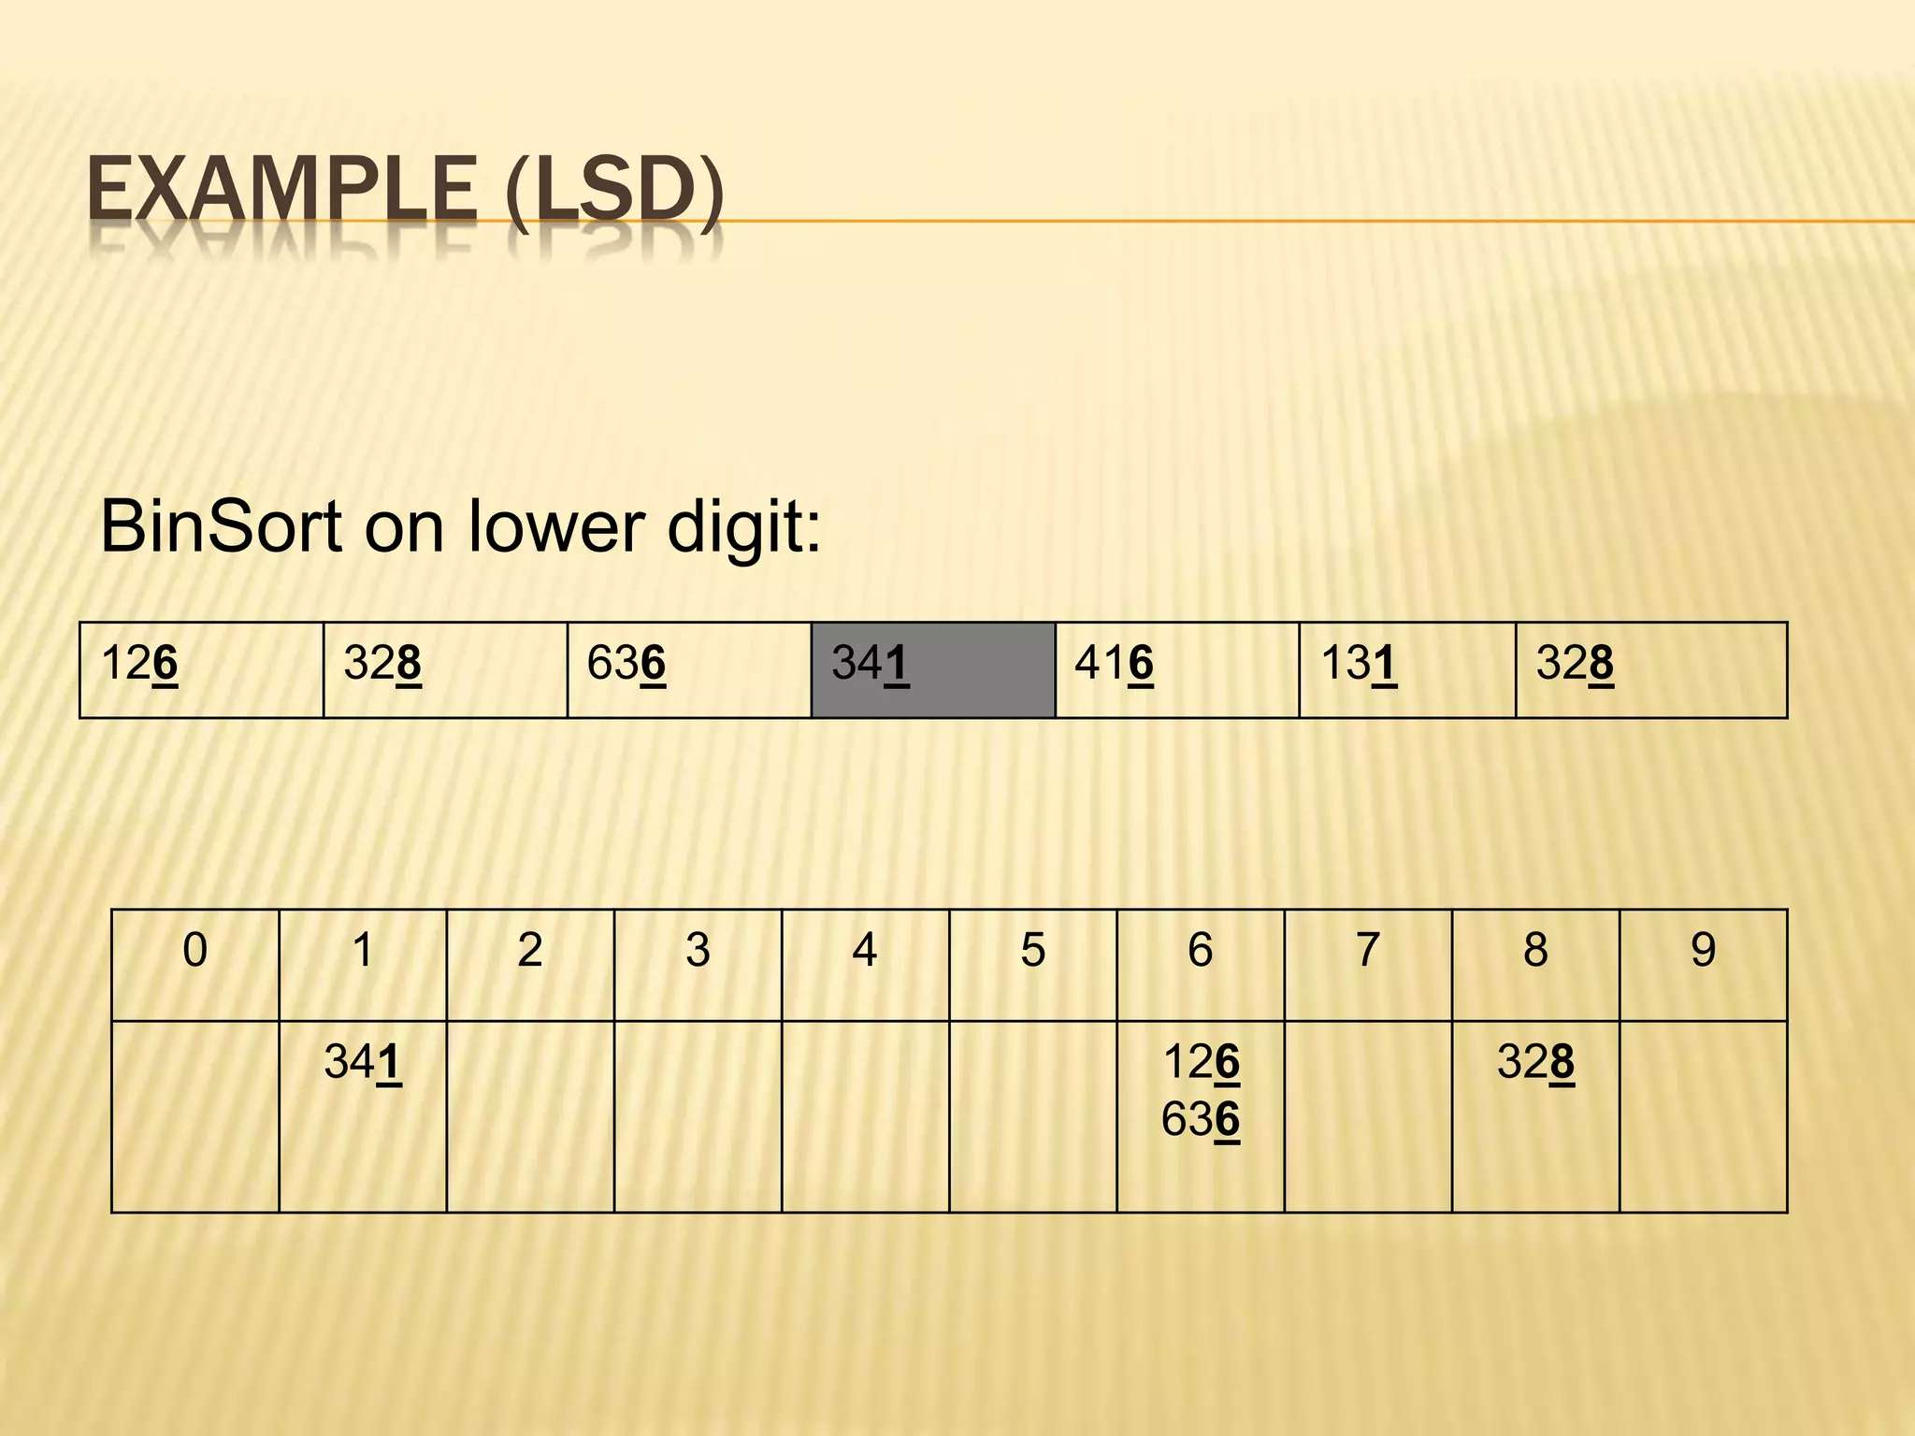
PASS 1:

Slide 10
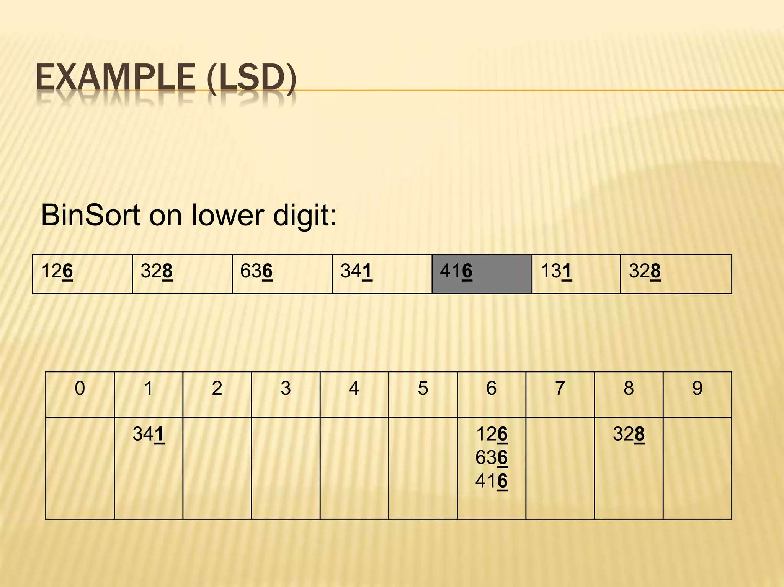
PASS 1:

Slide 11
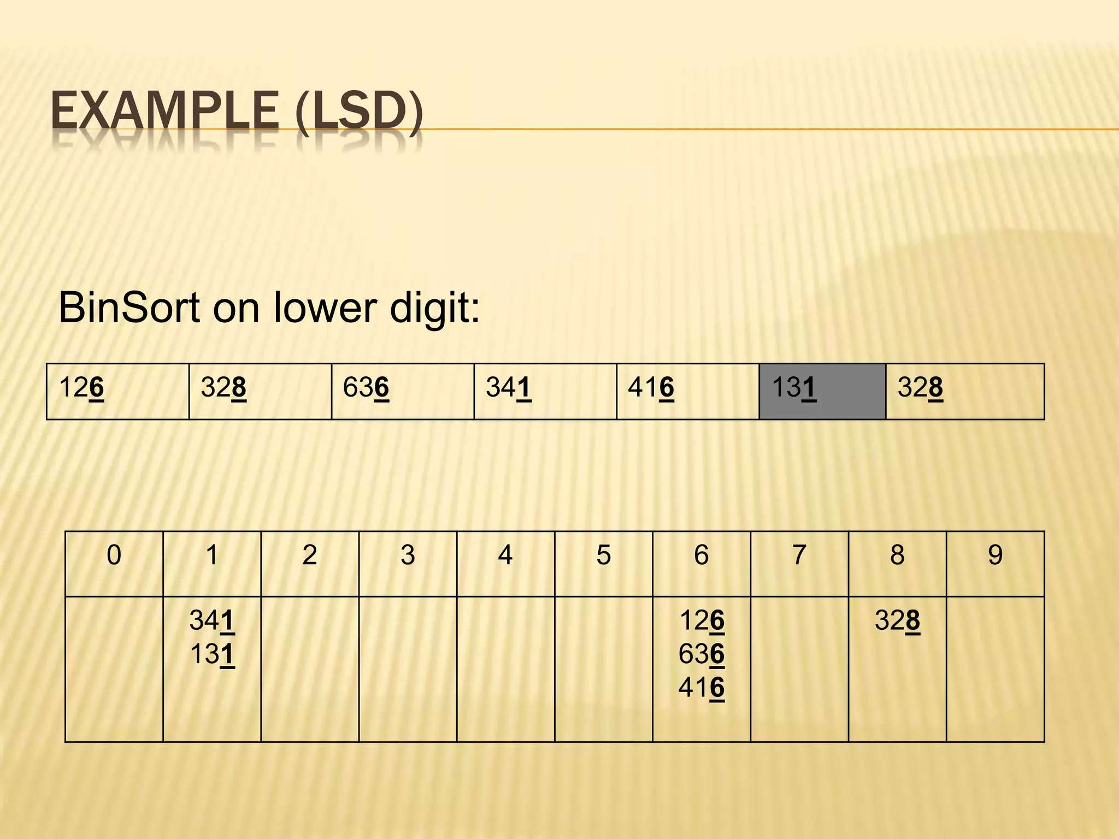
PASS 1:

Slide 12
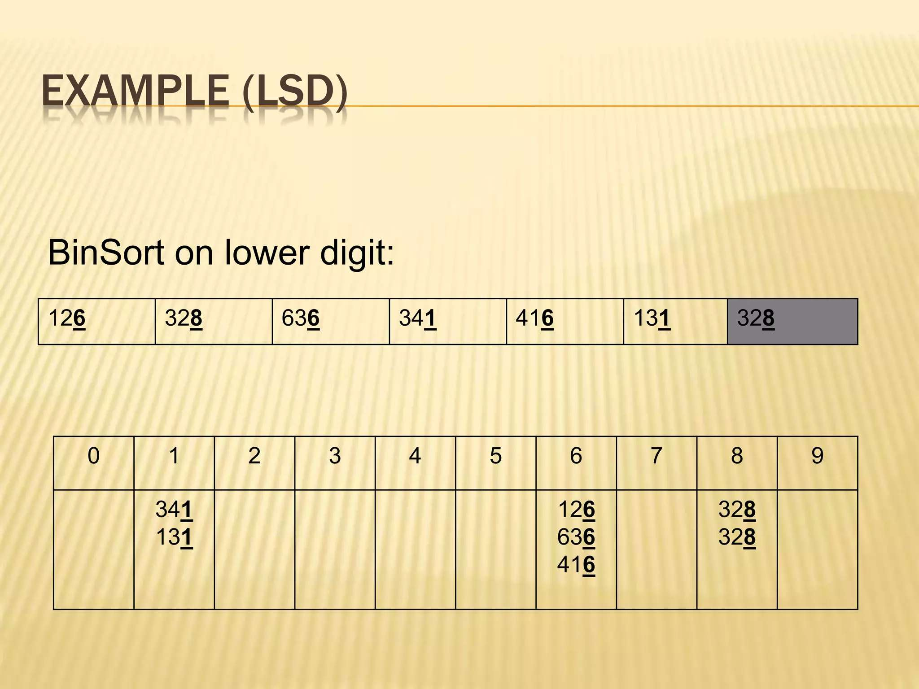
PASS 1:

Slide 13
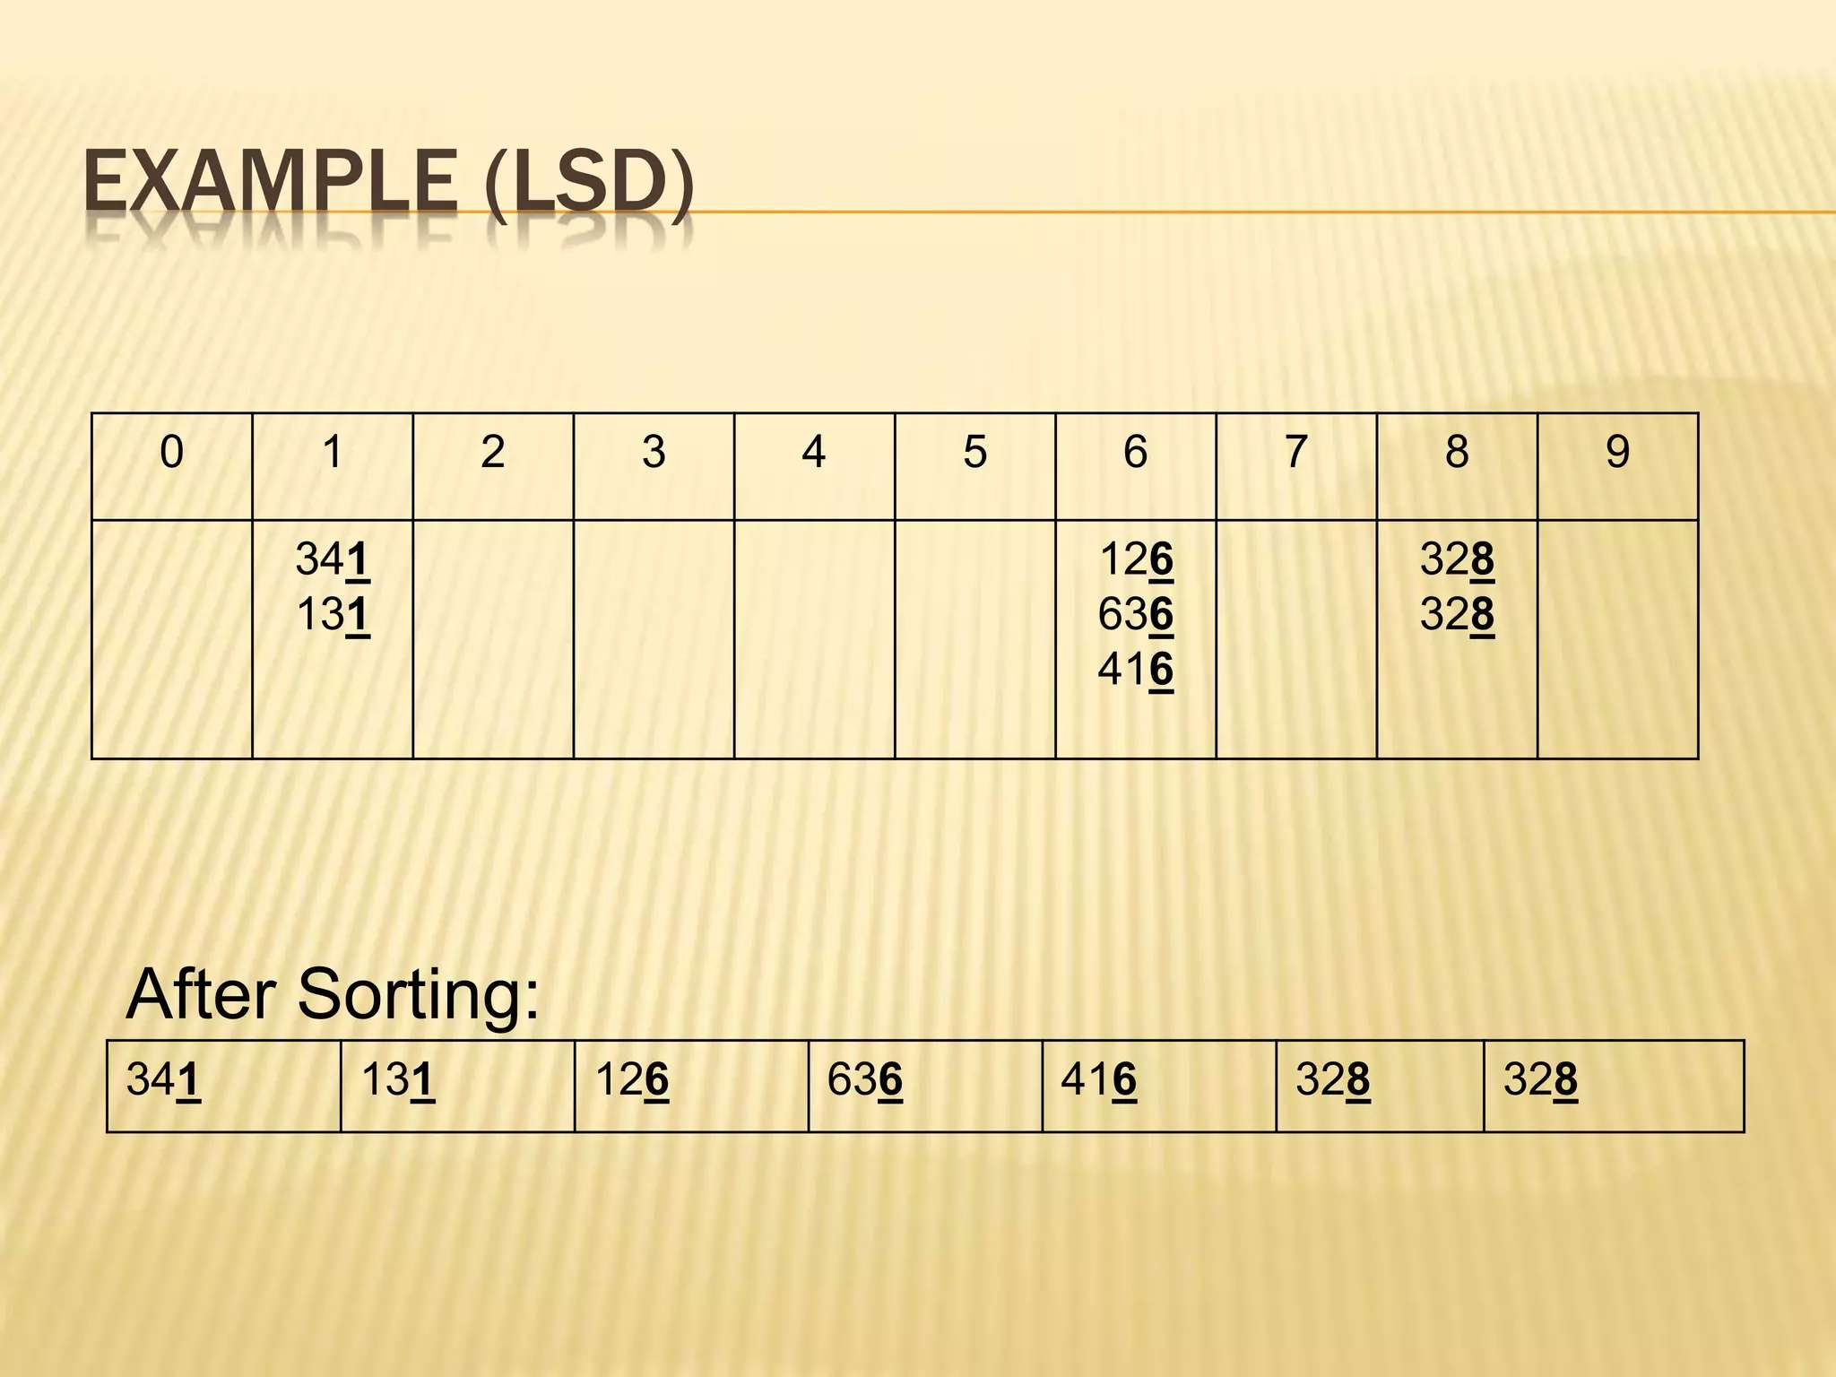

Slide 14
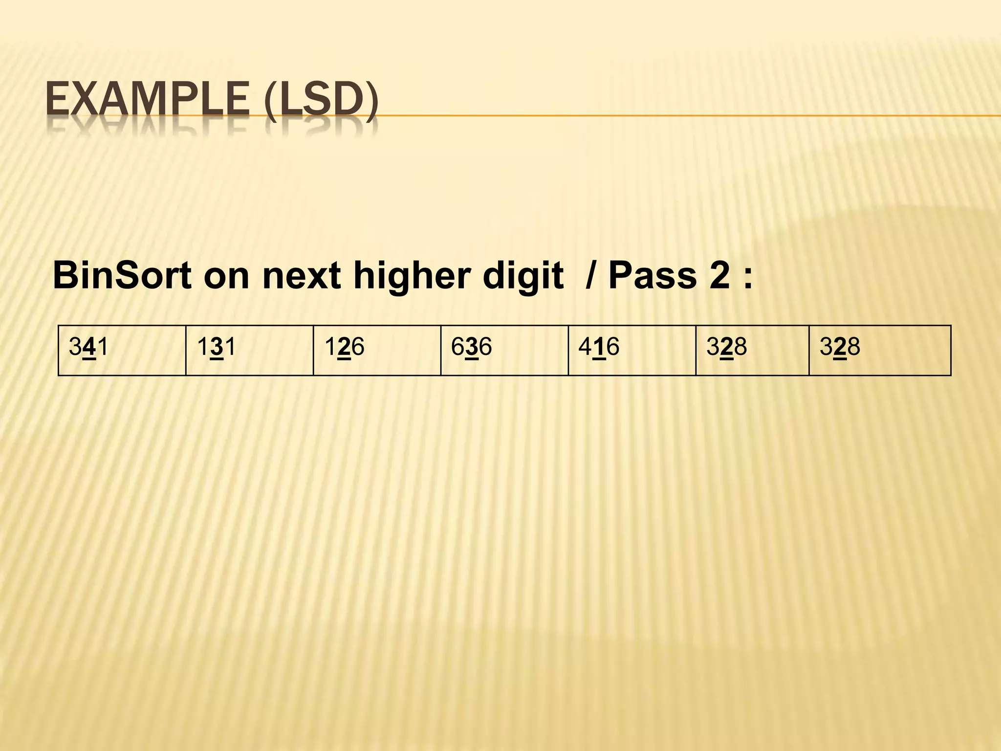
PASS 2:

Slide 15
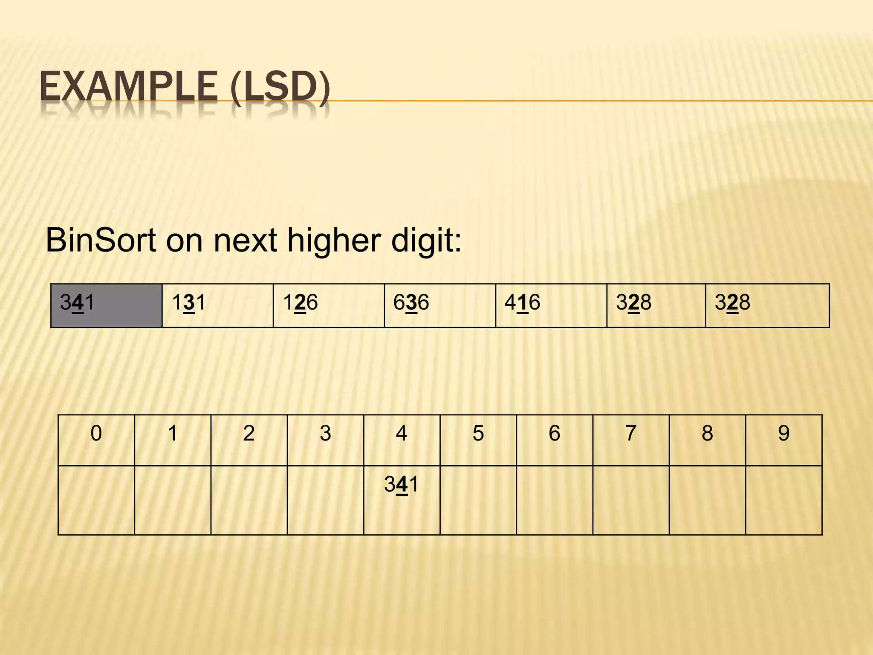
PASS 2:

Slide 16
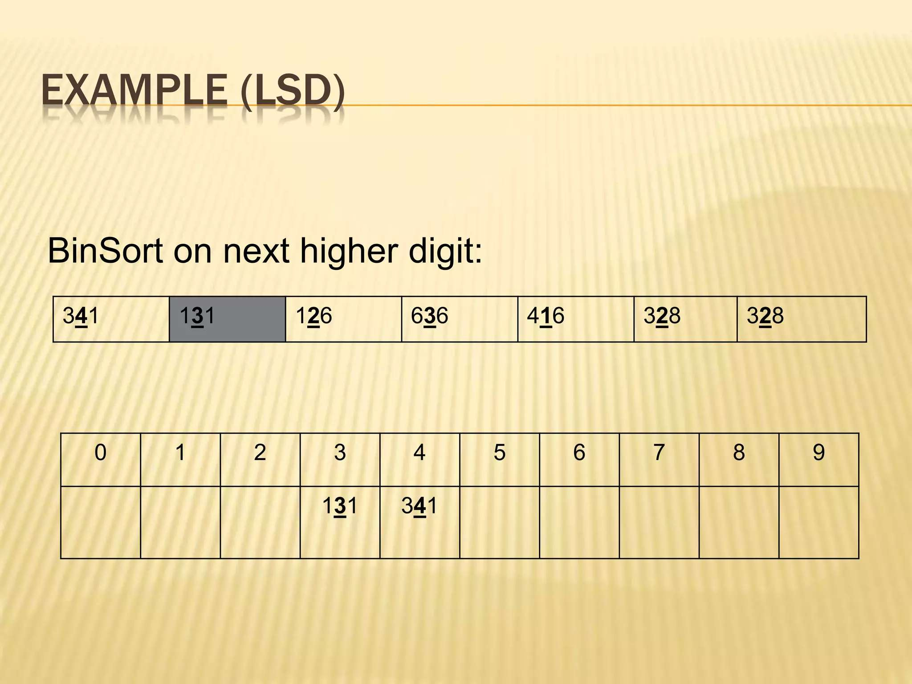
PASS 2:

Slide 17
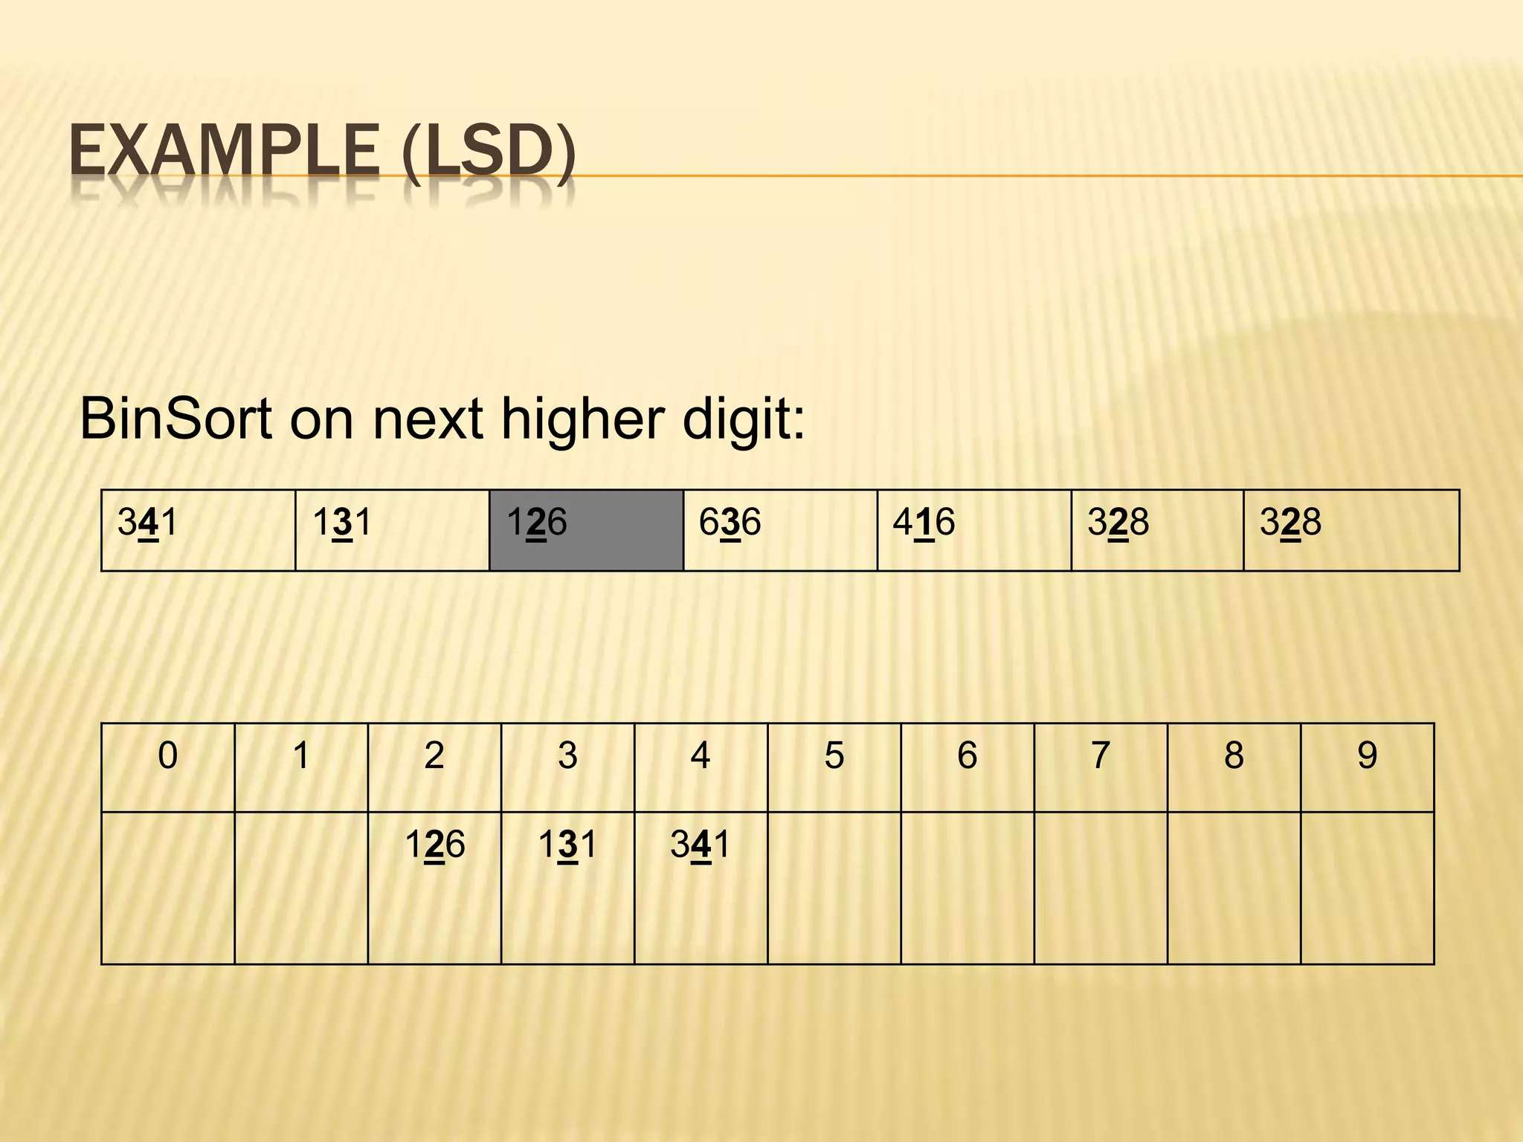
PASS 2:

Slide 18
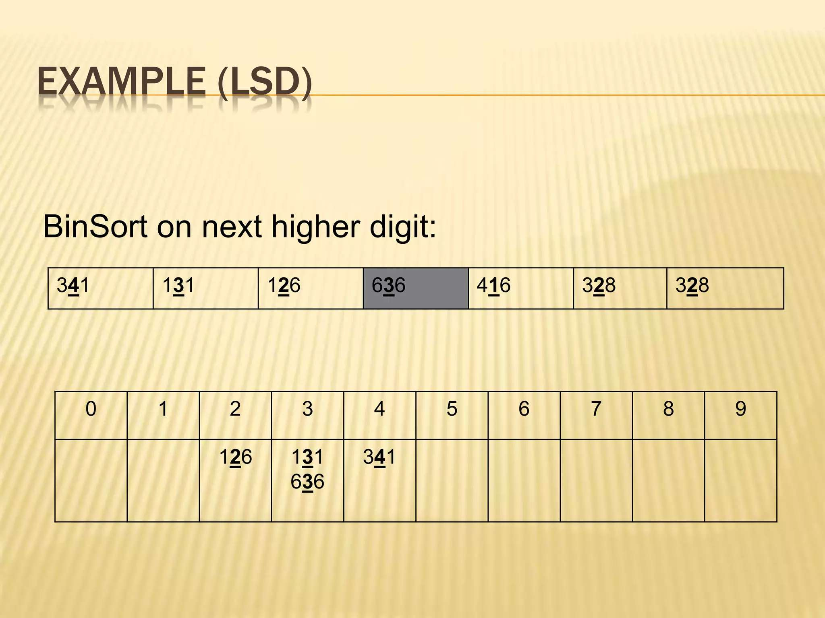
PASS 2:

Slide 19
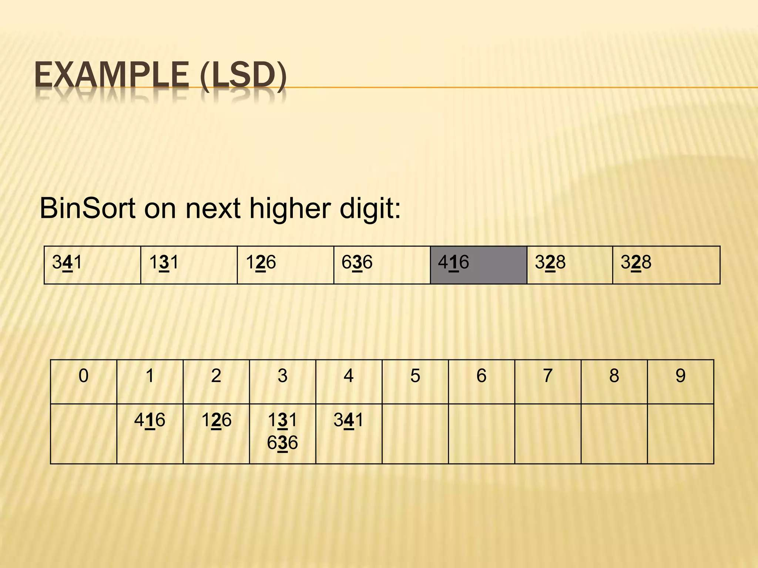
PASS 2:

Slide 20
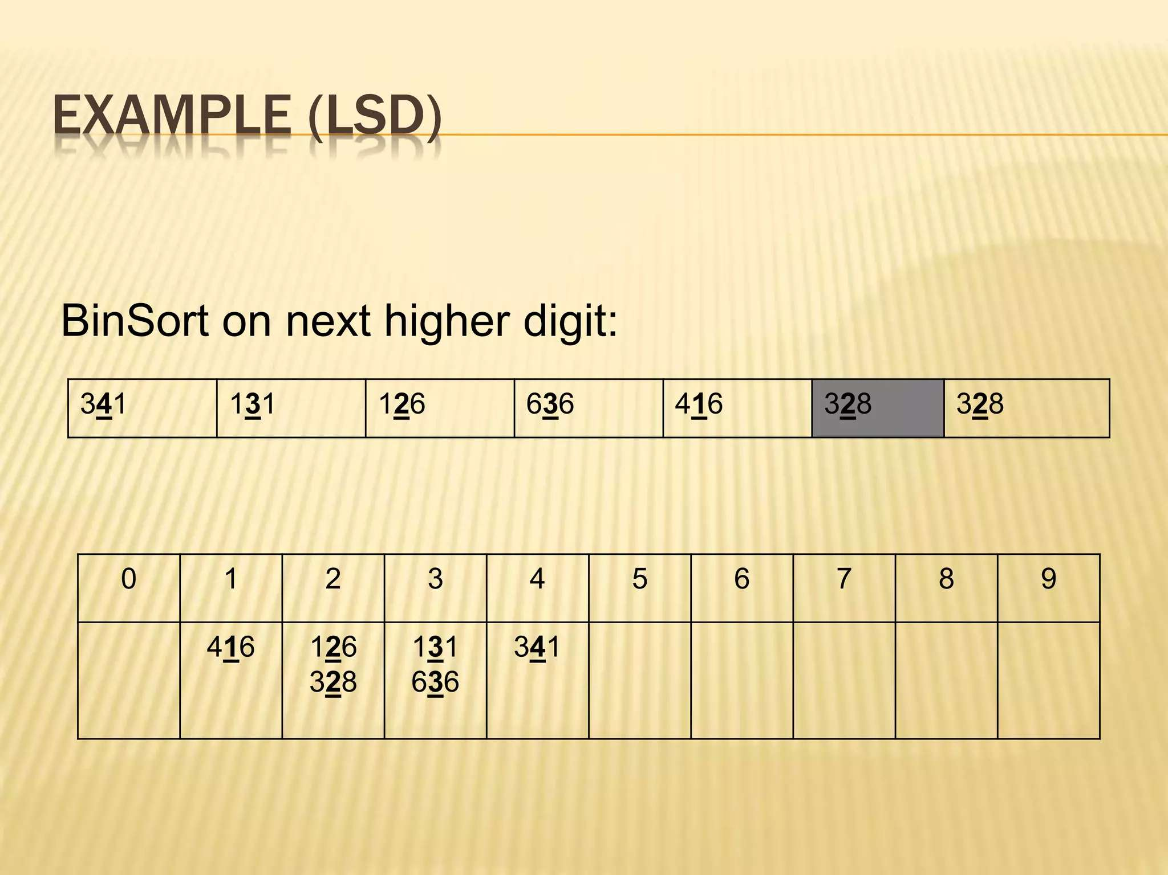
PASS 2:

Slide 21
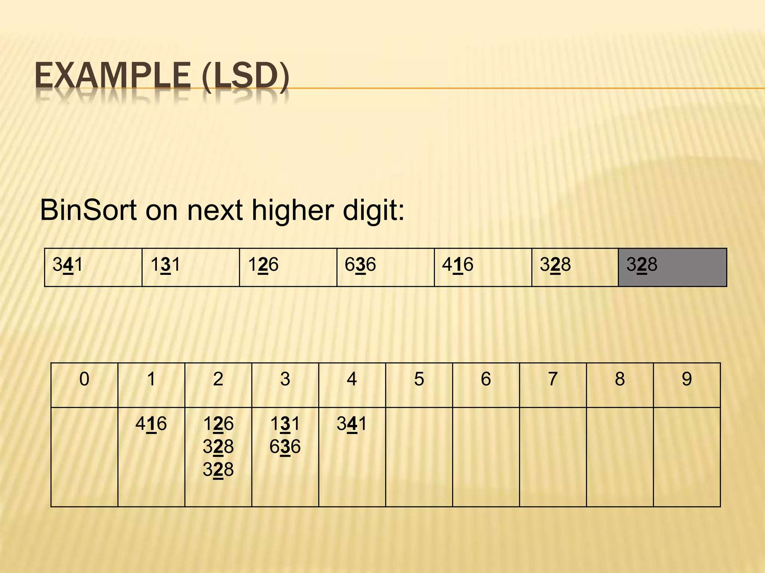
PASS 2:

Slide 22
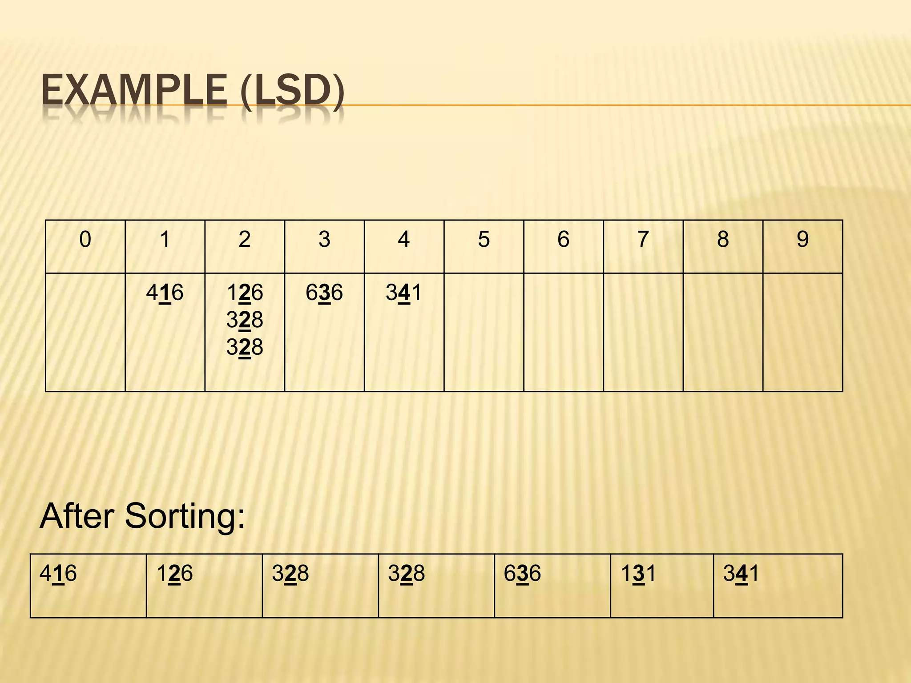

Slide 23
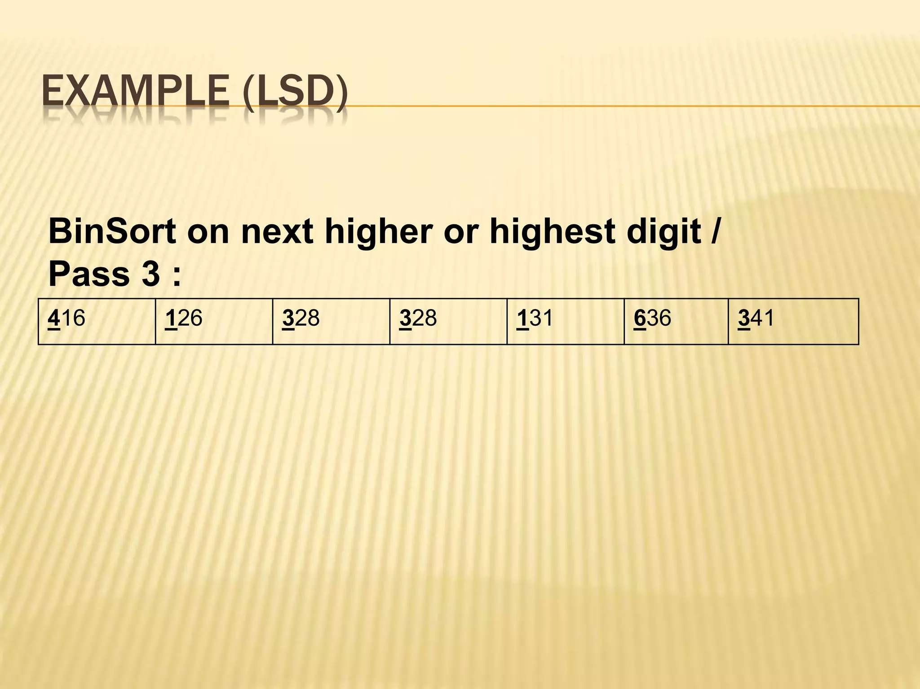

Slide 24
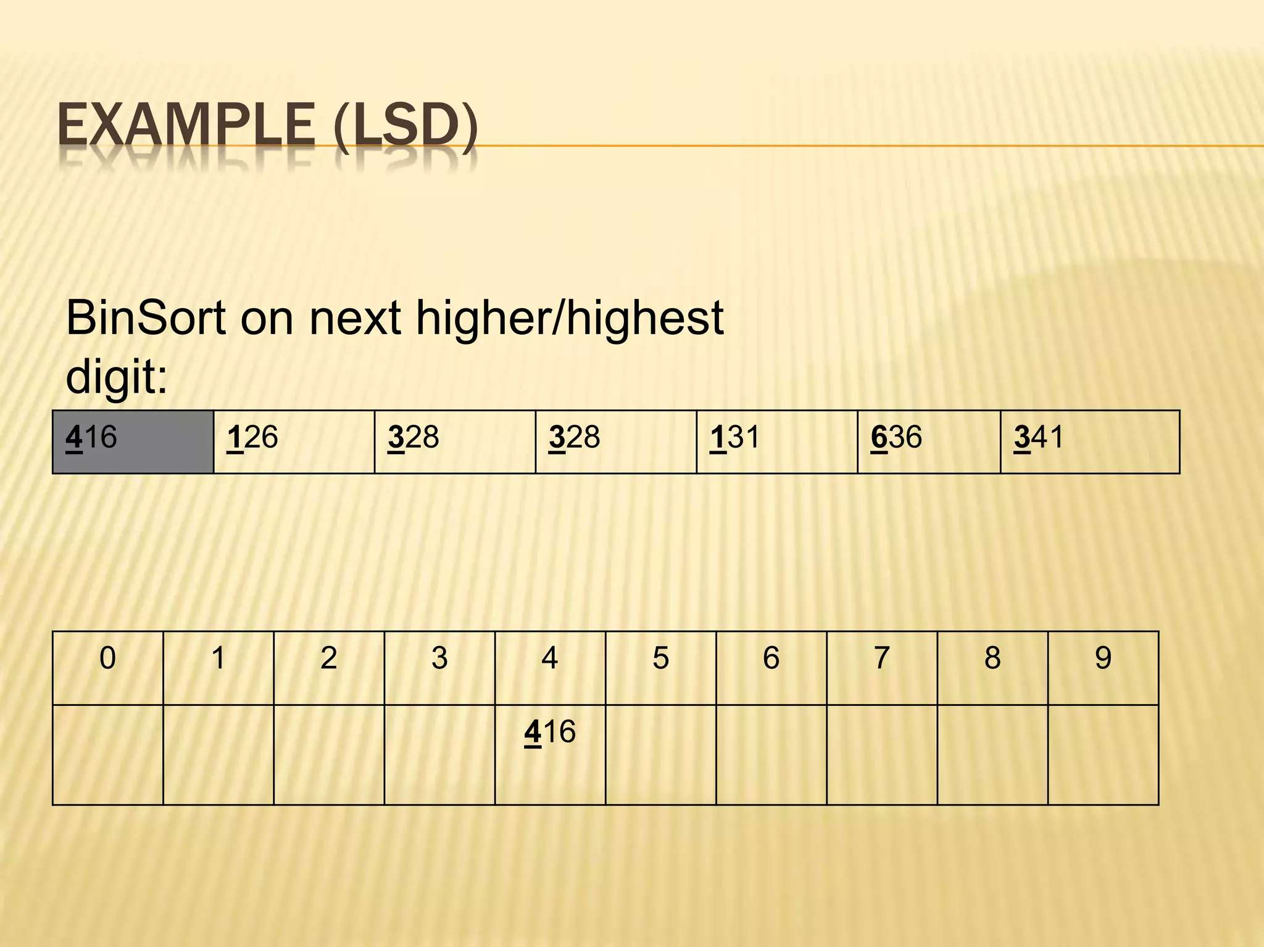
PASS 3:

Slide 25
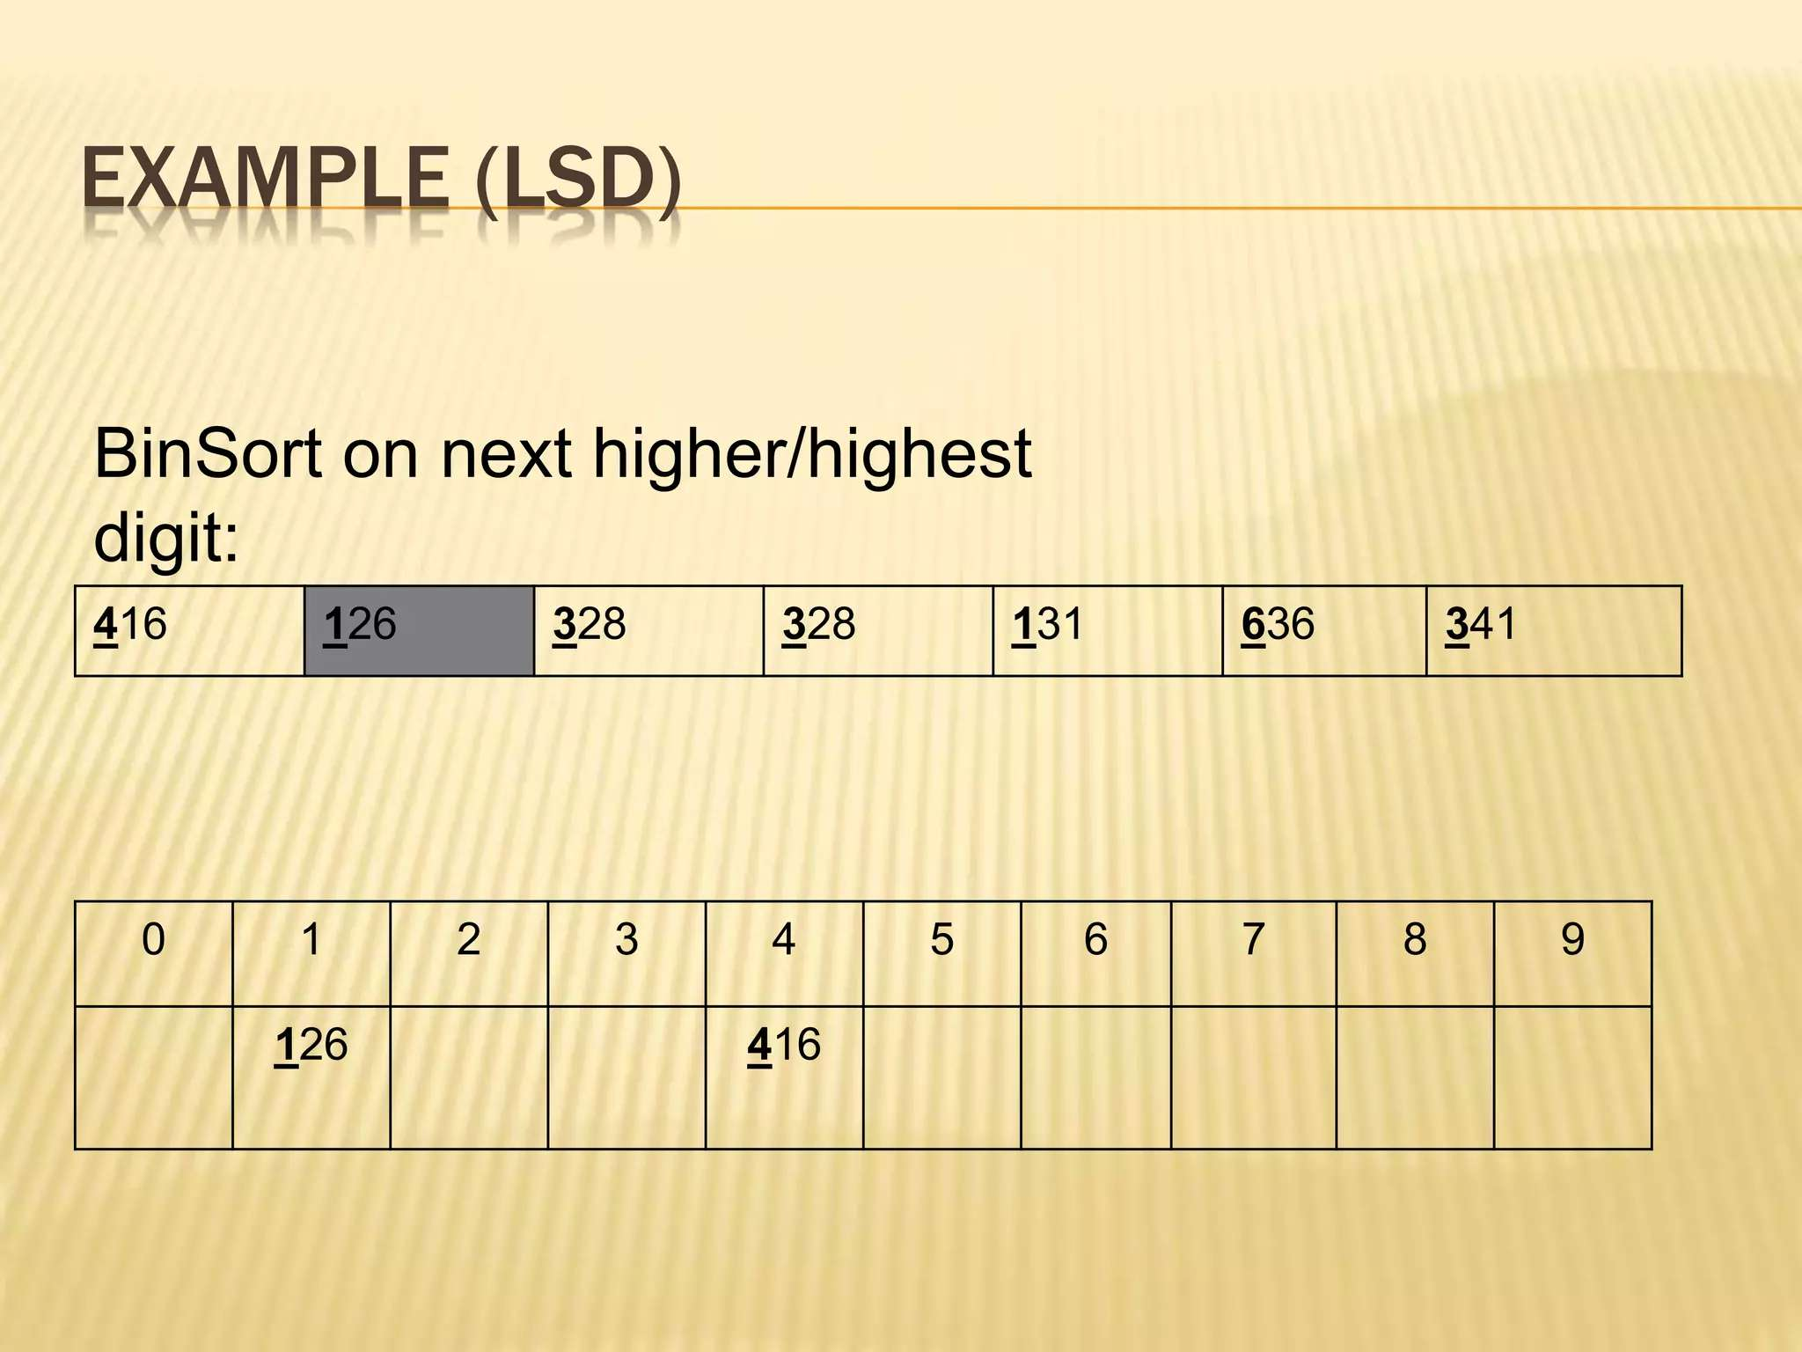
PASS 2:

Slide 26
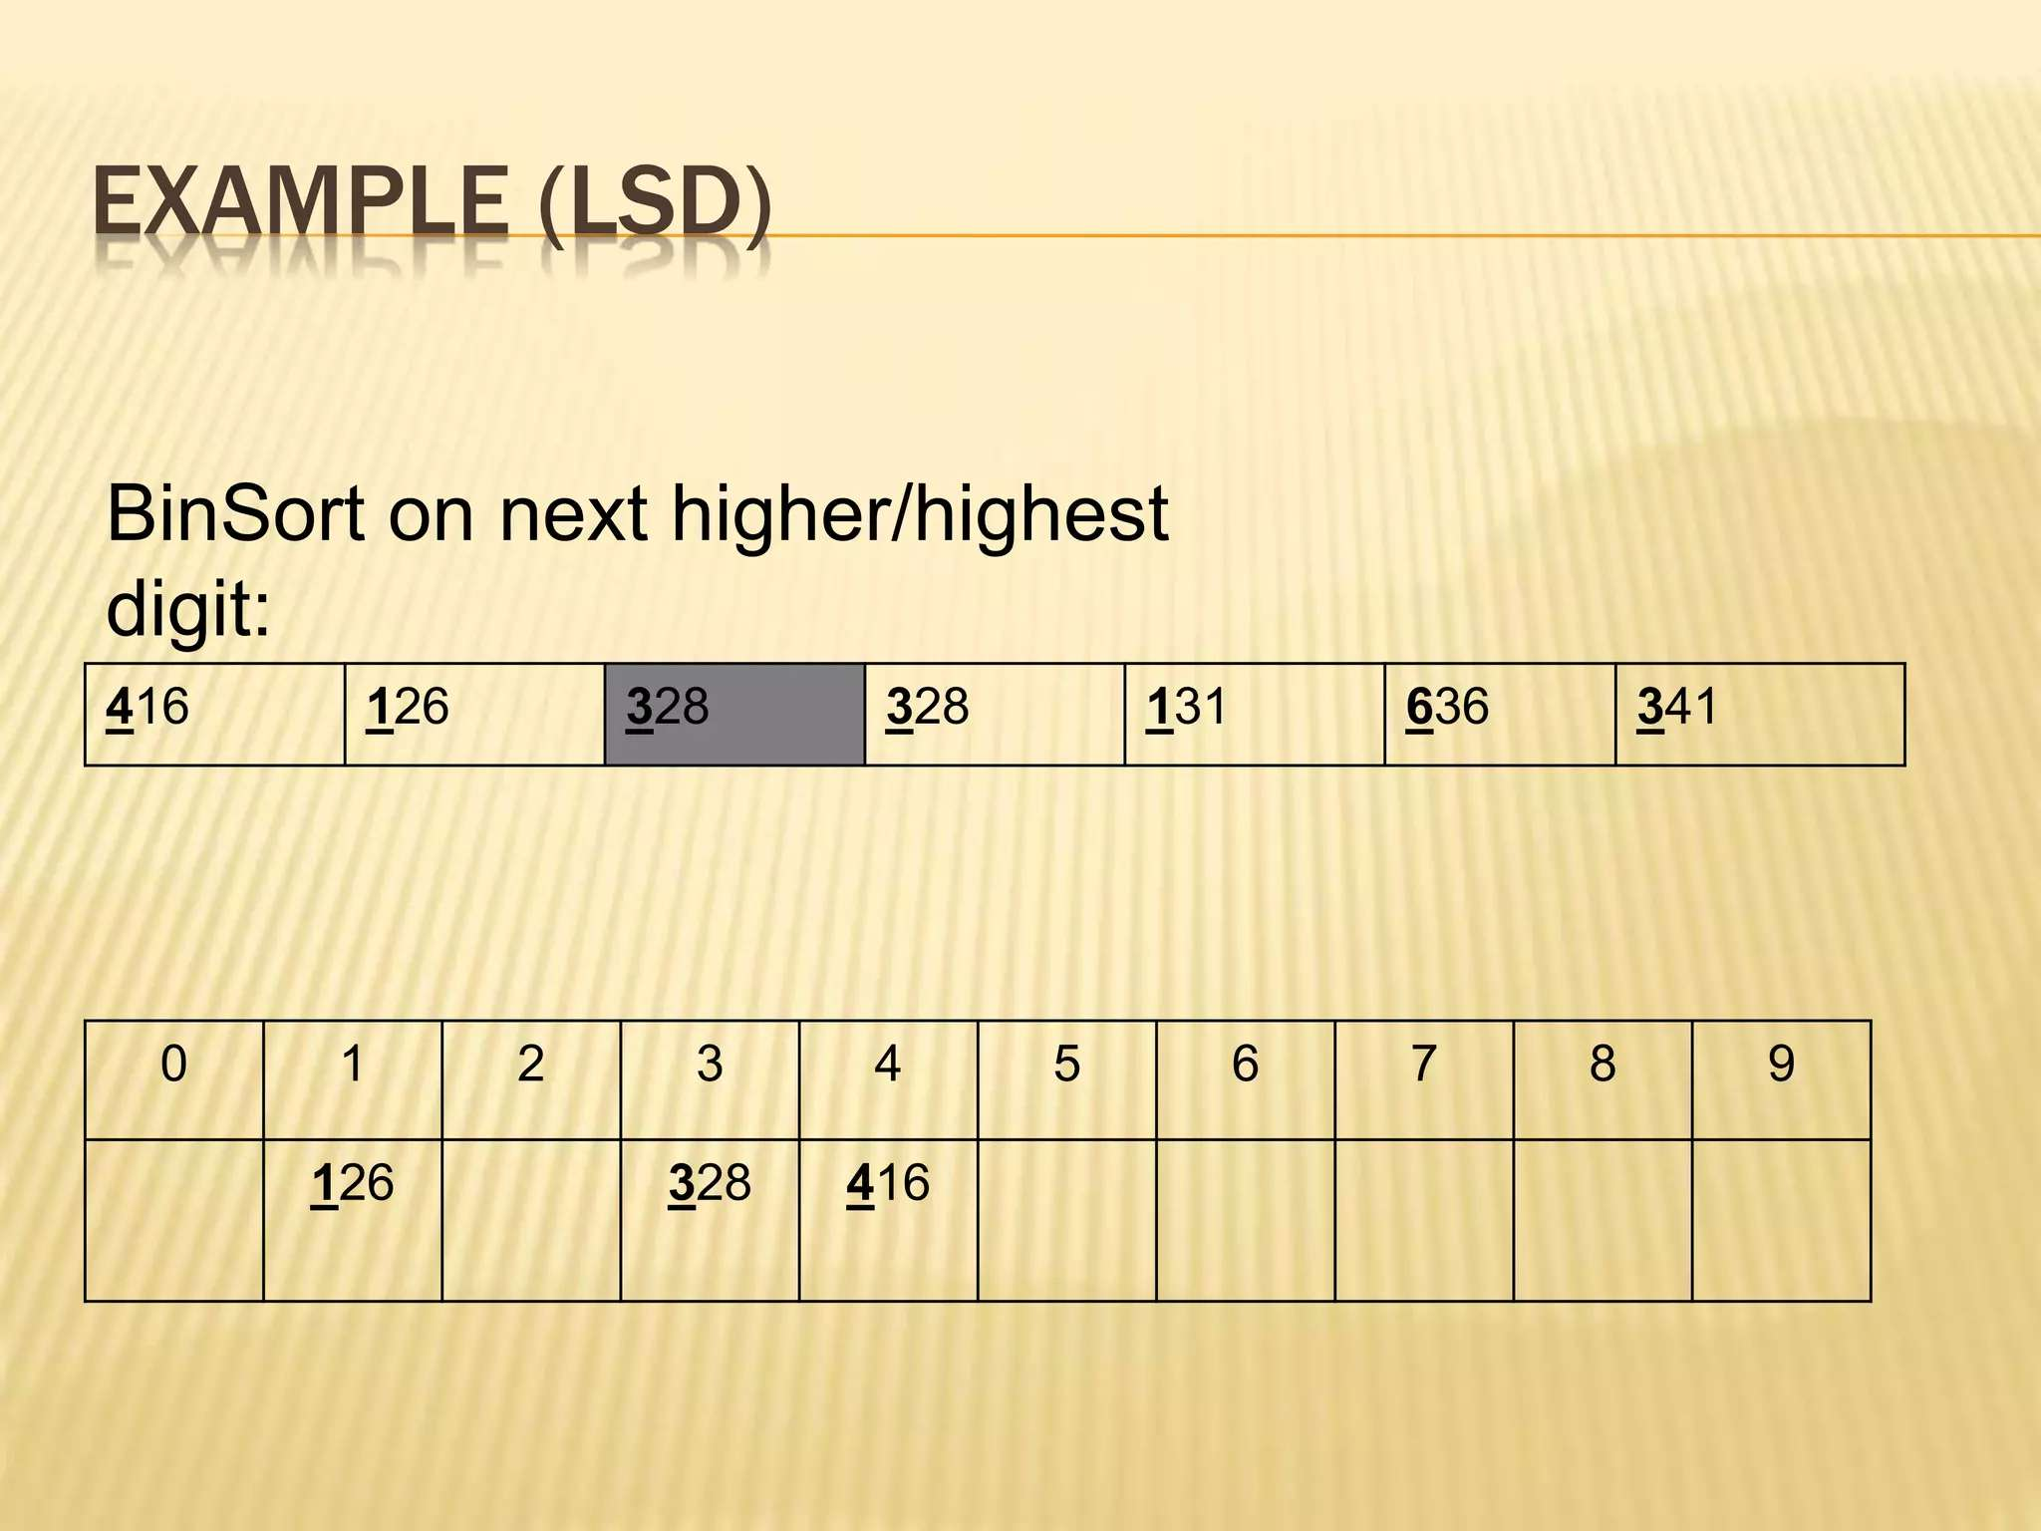
PASS 2:

Slide 27
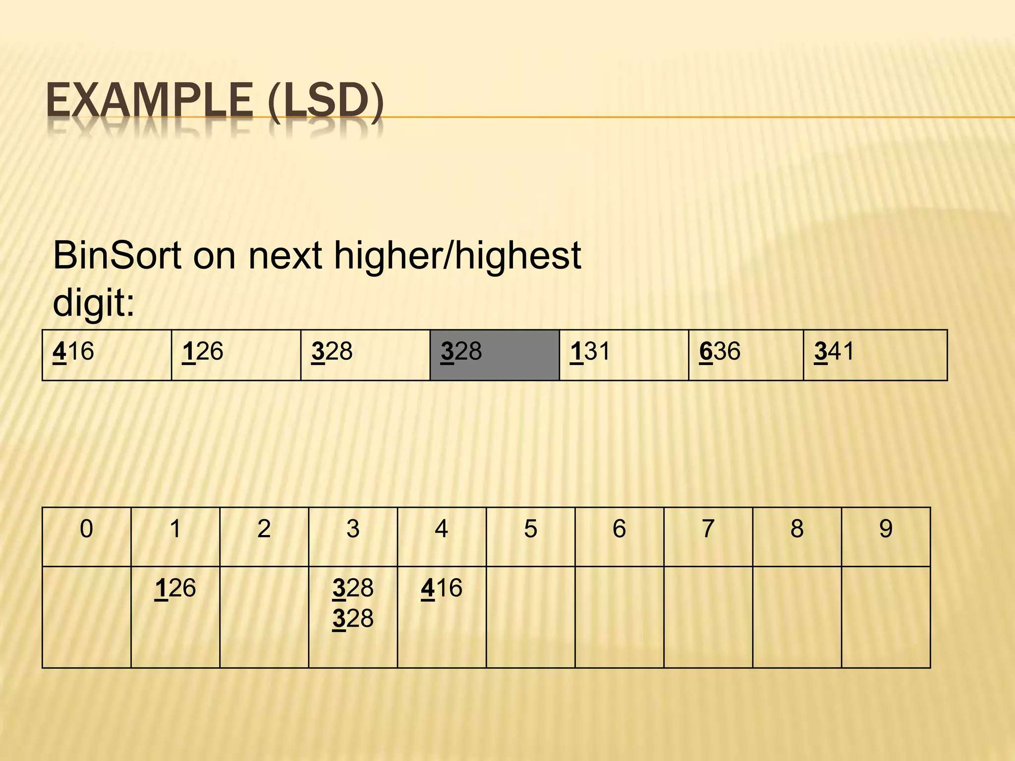
PASS 2:

Slide 28
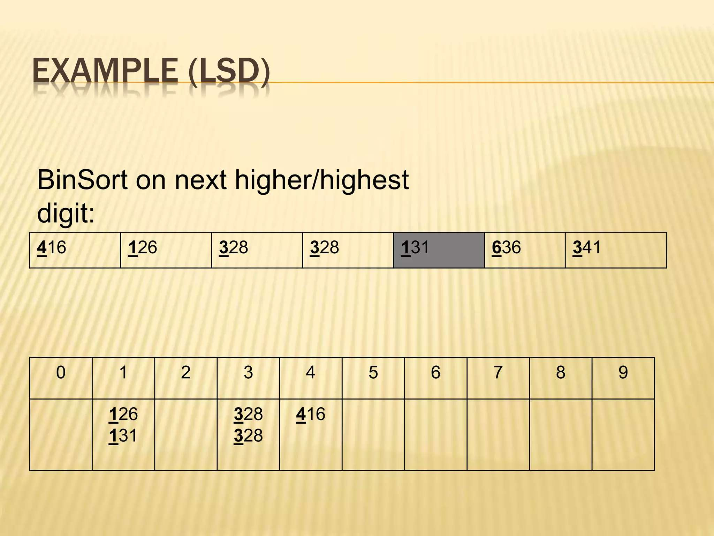

Slide 29
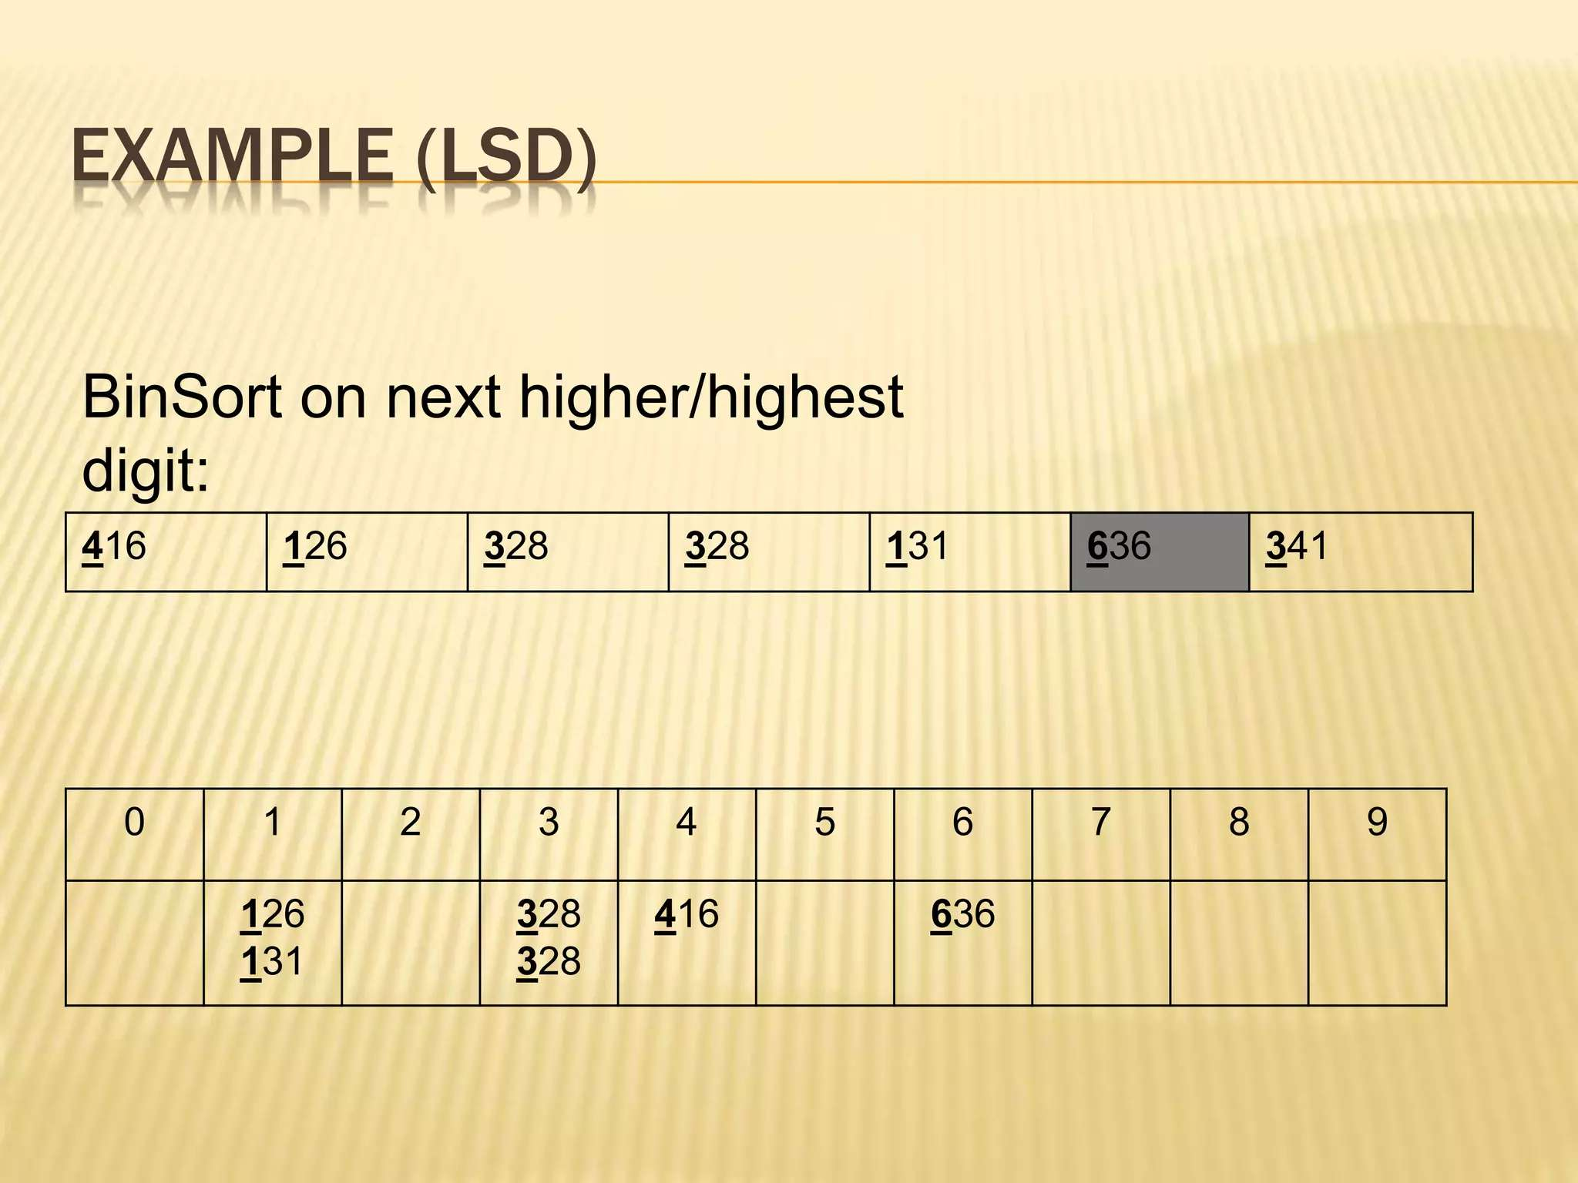
PASS 2:

Slide 30
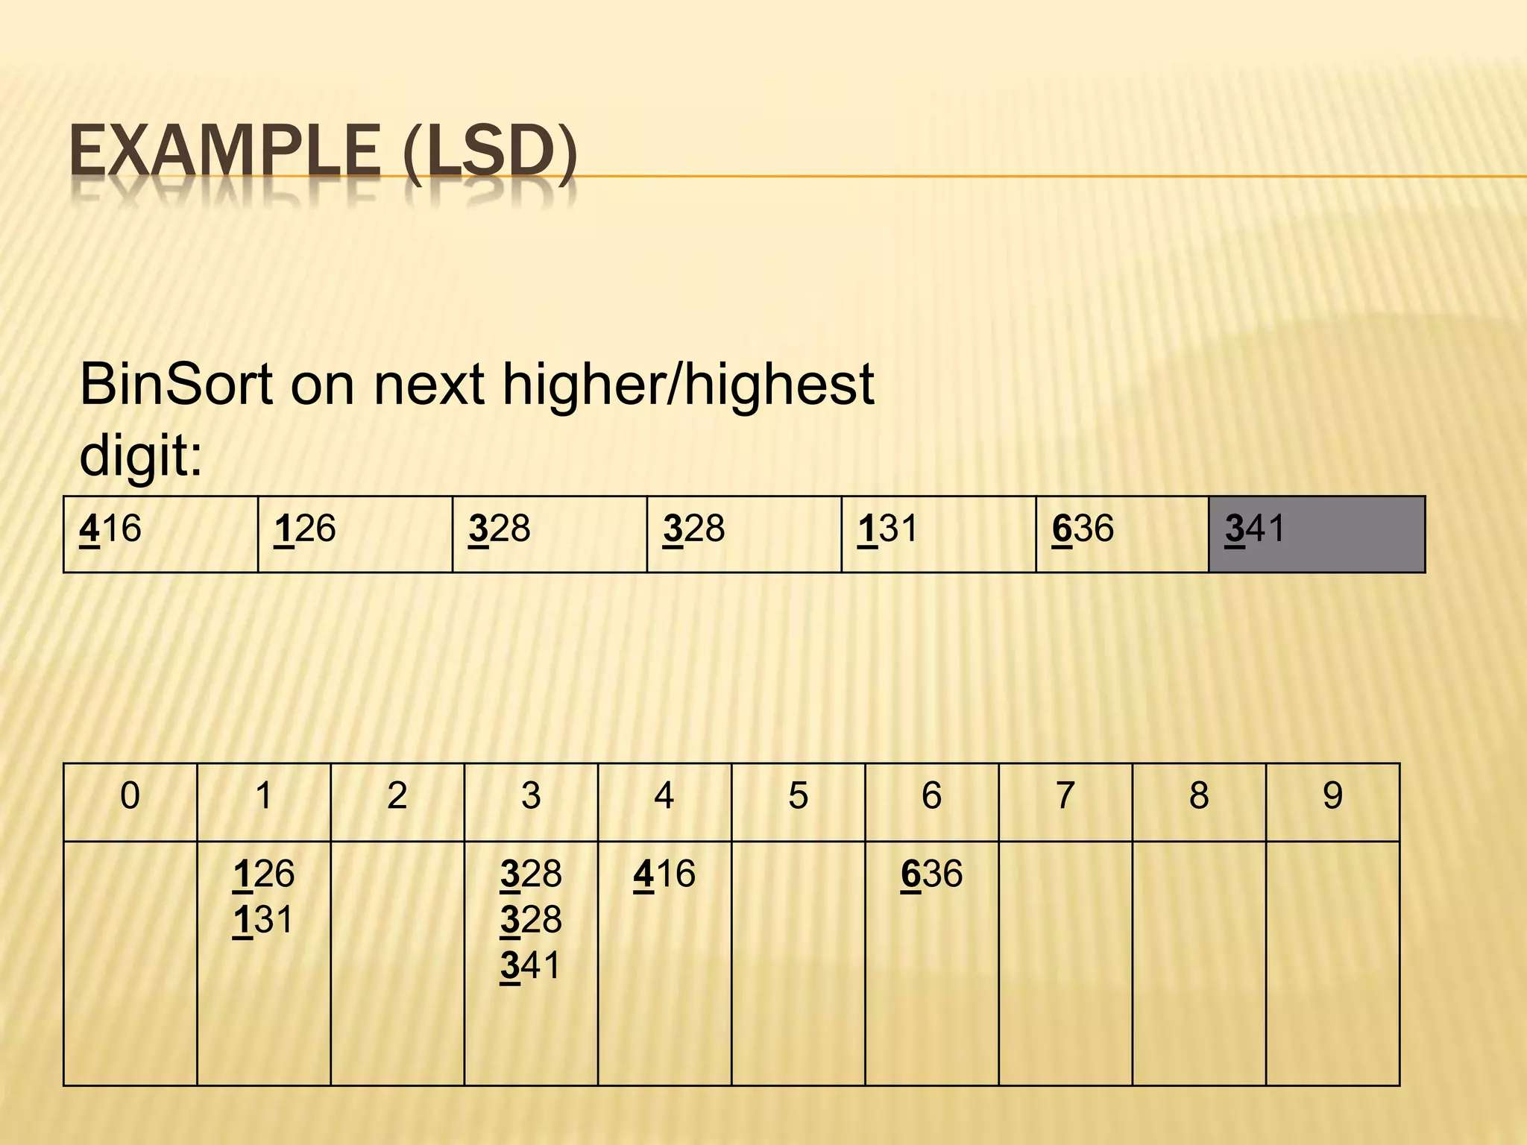

Slide 31
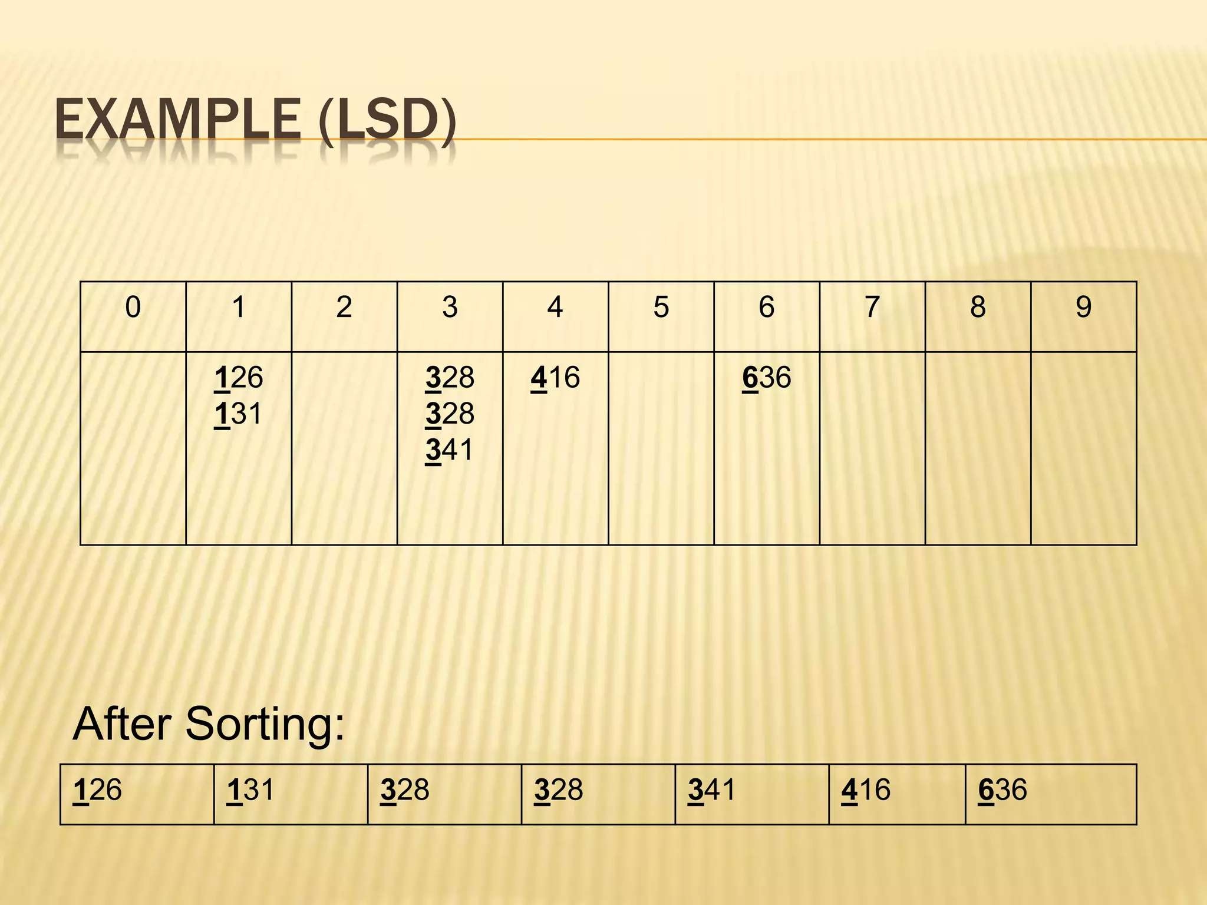

Slide 32
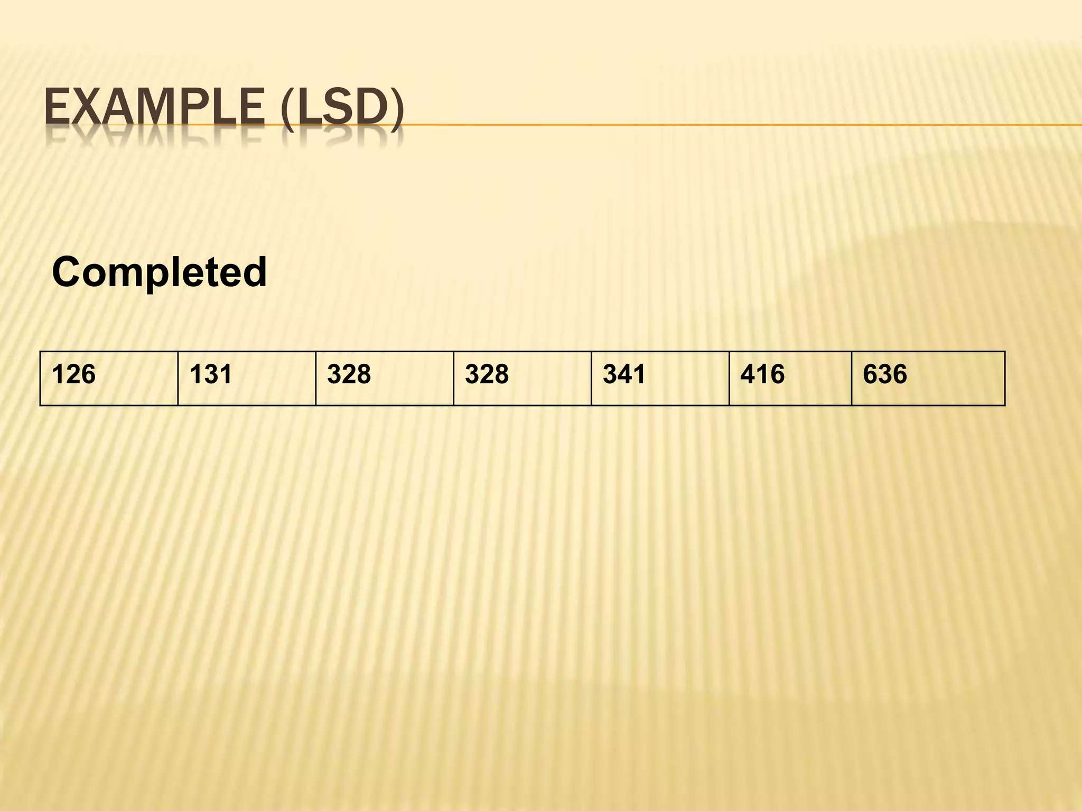

Slide 33
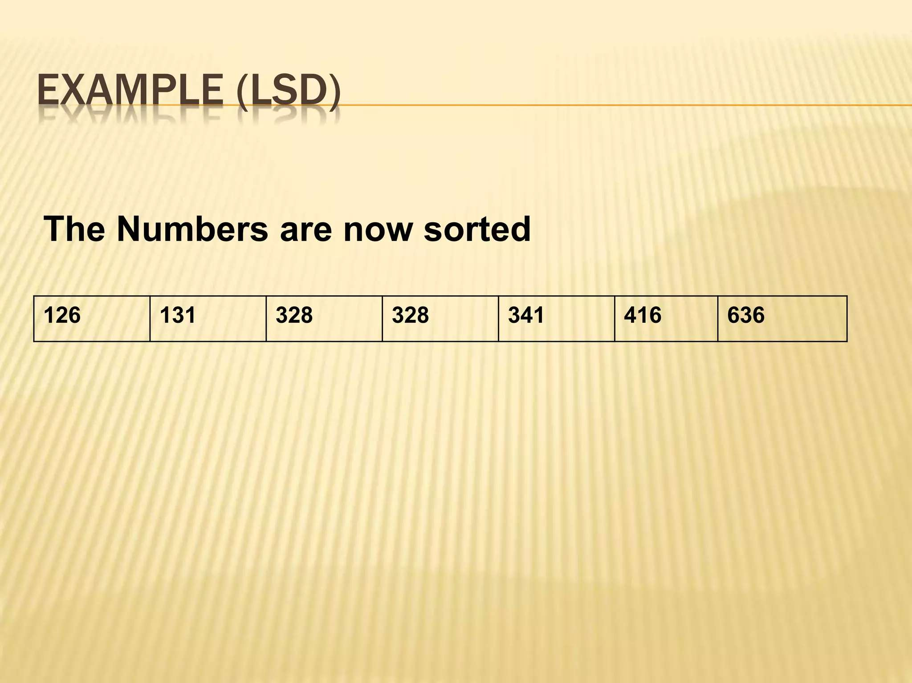

Slide 34
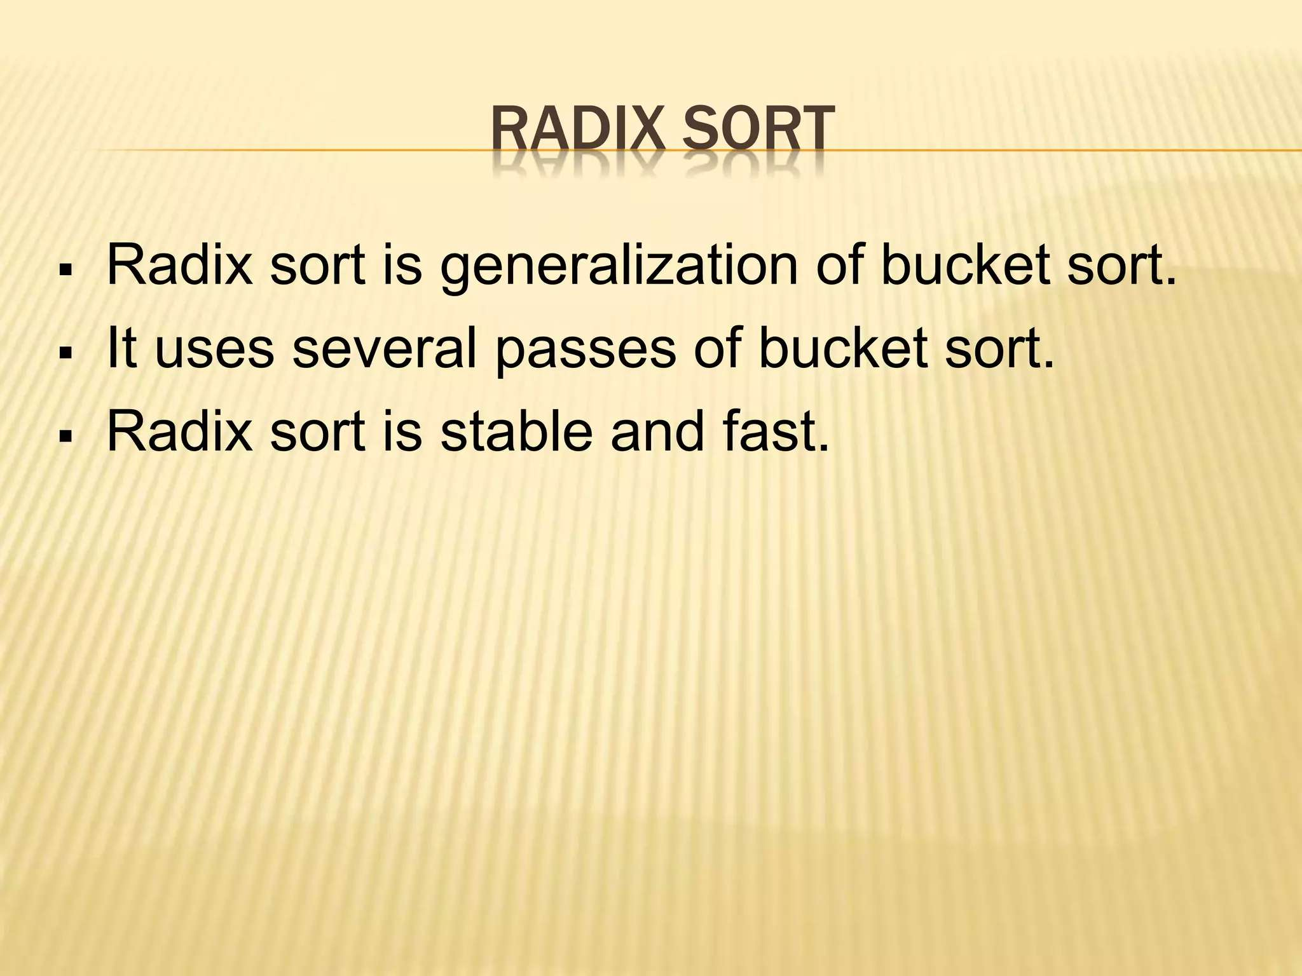

Slide 35
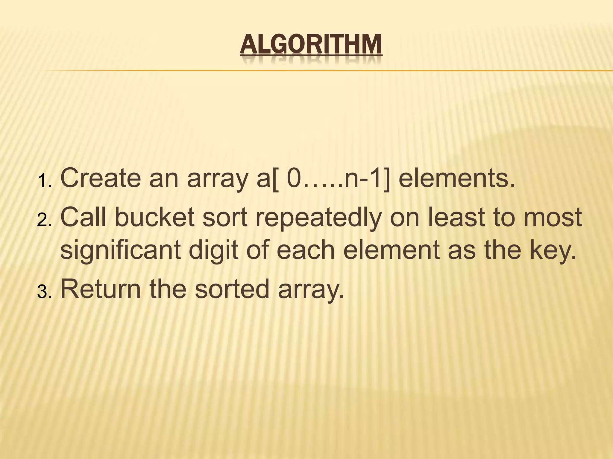

Slide 36
Applications of Radix Sort
Sorting Large Sets of Integers: Efficient for large datasets with fixed-size numbers (e.g., timestamps, phone numbers).
Lexicographic Sorting of Strings: Useful for sorting words, file names, and URLs.
Database and External Sorting: Ideal for sorting large datasets with fixed-length keys, especially when data doesn't fit in memory.

Slide 37
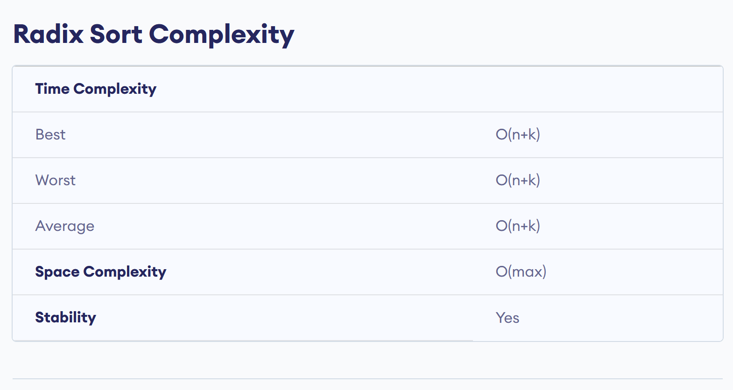

Slide 38
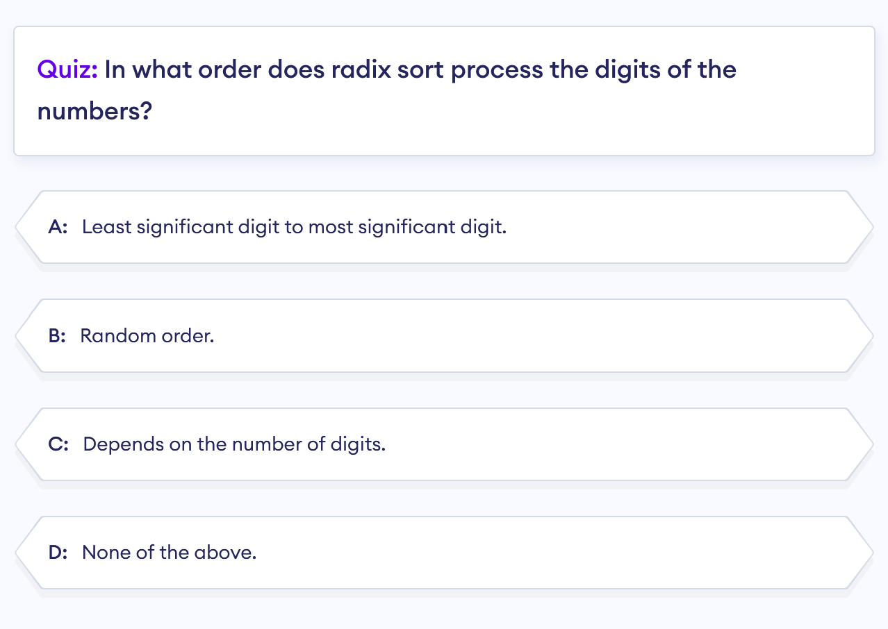

Slide 39
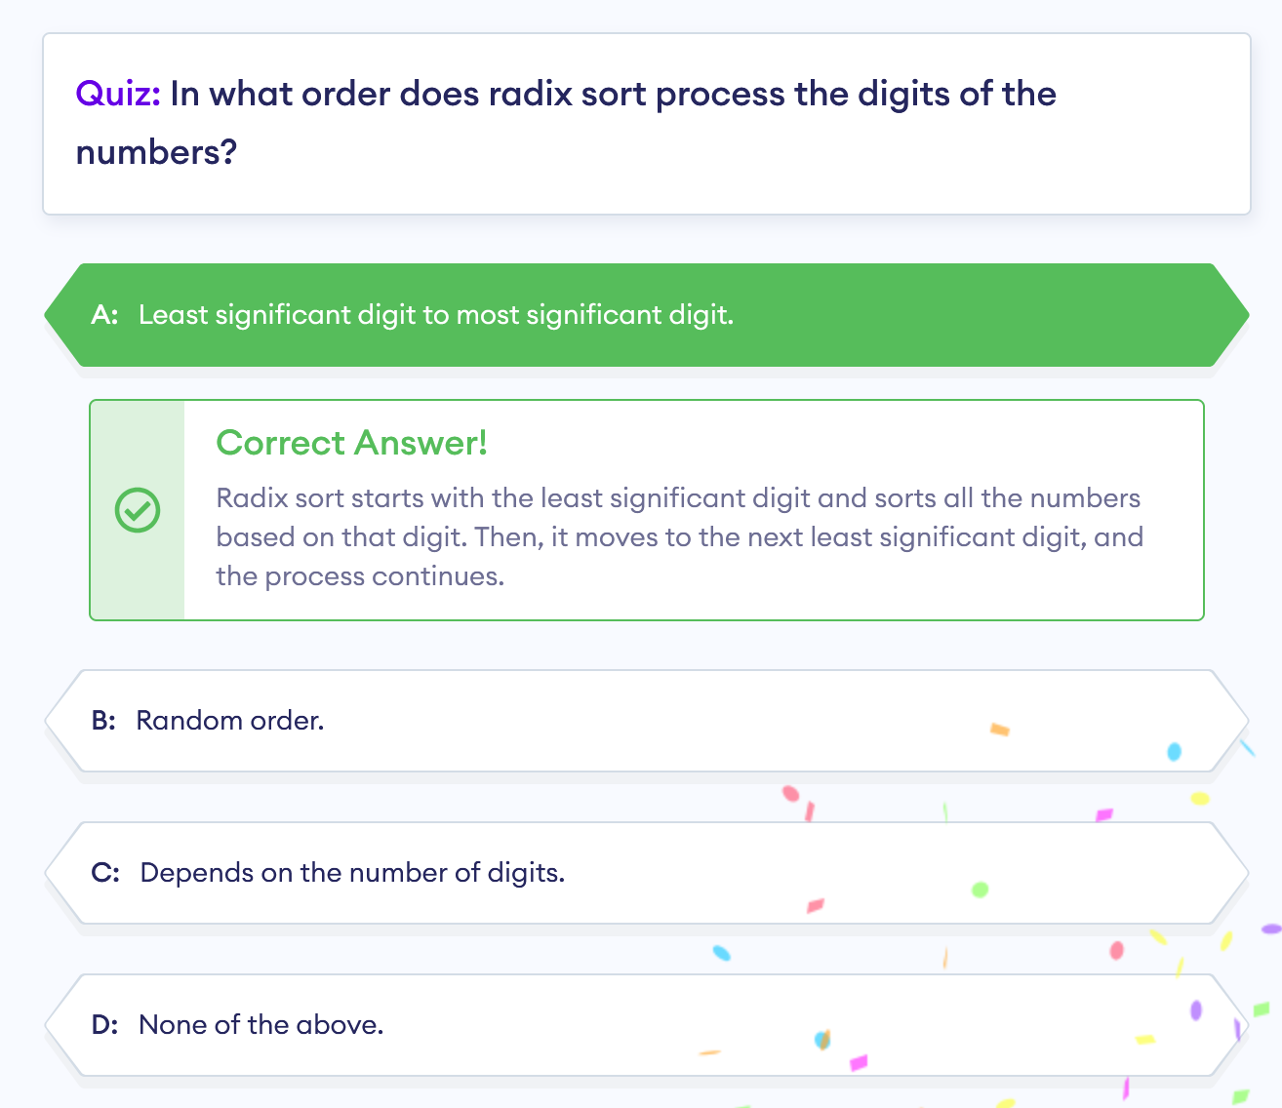

Slide 40
Important links
https://youtu.be/5n8KZnQvf4k

